Slide 1


Disclaimer for Customer Training: ISO New England (ISO) provides training to enhance participant and stakeholder understanding. Not all issues and requirements are addressed by the training. Consult the effective Transmission, Markets and Services Tariff and the relevant Market Manuals, Operating Procedures and Planning Procedures for detailed information. In case of a discrepancy between training provided by ISO and the Tariff or Procedures, the meaning of the Tariff and Procedures shall govern.
February 21, 2019 WebEx Broadcast
Presentation updated 11/17/2025. Impacted slides are noted.
Continuous Storage Facility Participation
Part of the Enhanced Storage Participation Revisions and Energy Storage Device Project
Tim Peet
Manager, Customer Support
Jacques Asselin
Lead Analyst, Asset Registration & New Generation Coordination
Sarthak Pant
Sr. Settlement Analyst, Hourly Markets, Settlements
ISO-NE PUBLIC
ISO-NE PUBLIC

Slide 2
Disclaimer for Customer Training
ISO New England (ISO) provides training to enhance participant and stakeholder understanding. Because not all issues and requirements are addressed by the training, participants and other stakeholders should not rely solely on this training for information but should consult the effective Transmission, Markets and Services Tariff (“Tariff”) and the relevant Market Manuals, Operating Procedures and Planning Procedures (“Procedures”).
Training examples are provided for illustrative purposes only. Company names and
numerical values used are fictitious.
In case of a discrepancy between training provided by ISO and the Tariff or Procedures, the meaning of the Tariff and Procedures shall govern.
Presentation assumes approval of Enhanced Storage Participation Revisions (ER19–84–000).

Slide 3

Disclaimer
This presentation demonstrates all the components of a Continuous Storage Facility. A storage facility incapable of receiving and storing electricity from the grid may participate in the New England Markets as a Continuous Storage Facility, so long as that facility satisfies all Continuous Storage Facility registration and participation requirements that are not solely related to consumption capability. As a result, the Asset Related Demand (ARD) portion, except for registration, can be disregarded.
Slide added on 12/31/2024.

Slide 4


Recent FERC Orders Affecting CSF Participation
FERC Order 2222
FERC Order 841
Nov 2026 Implementation
New Day-Ahead State of Charge changes
2222
841
Watch the FERC Order 2222 Explainer Video
Watch the FERC Order 841 Explainer Video
Slide updated on 11/17/2025.

Slide 5

Topics
Continuous Storage Facility (CSF) Option
Market Participation by Continuous Storage Facilities
Initial Modeling, Technical Requirements, and Asset Registration
eMarket Requirements
Examples of How a CSF May Offer or Bid into Markets
Settlements and Billing Impacts

Slide 6

Objectives
Identify continuous storage facility (CSF) option
Describe how to register as continuous storage facility (CSF)
Recall requirements for managing CSF assets in eMarket software platform
Give examples of how CSF may offer or bid in to markets
Recognize CSF settlement details
Locate helpful information, including alternative options that storage facilities have for market participation

Slide 7
Acronyms
AGC | automatic generation control |  | MR1 | Market Rule 1 (Section III of ISO Tariff)
ARD | asset-related demand |  | MW | megawatt
ATRR | alternative technology regulation resource |  | MWh | Megawatt-hour
CLAIM10 | offline 10-minute nonspinning reserves |  | MyFacility_ARD | CSF’s DARD
CLAIM30 | offline 30-minute operating reserve |  | MyFacility_ATRR | CSF’s ATRR
CROW | Control Room Operations Window (interface) |  | MyFacility_GEN | CSF’s generator asset
CSF | continuous storage facility |  | NCPC | net commitment-period compensation
DAM | Day-Ahead Energy Market |  | NEPOOL | New England Power Pool
DARD | dispatchable asset-related demand |  | NPCC | Northeast Power Coordinating Council
DDP | desired dispatch point |  | OP | operating procedure
DE | designated entity |  | PTF | pool transmission facility
Eco Max | economic maximum value |  | PURPA | Public Utility Regulatory Policies Act
Eco Min | economic minimum value |  | Reg High | regulation high value
ESD | energy storage device |  | Reg Low | regulation low value
FCM | Forward Capacity Market |  | RQM | revenue quality meter
FCTS | Forward Capacity Tracking System |  | RTM | Real-Time Energy Market
FERC | Federal Energy Regulatory Commission |  | RTU | remote terminal unit
ISO-TEN | ISO Training & Events Network |  | SOG | settlement-only generator
LEG | limited-energy generator |  | TMNSR | 10-minute nonspinning reserves
LMP | locational marginal price; lead market participant |  | TMOR | 30-minute operating reserves
MIS | market information server |  | TMSR | 10-minute spinning reserves
7
ISO-NE PUBLIC

Slide 8


Market Rule References
Rules specific to continuous storage facilities are in Section III of ISO New England Inc. Transmission, Markets, and Services Tariff
‒ Section III known as Market Rule 1 (MR1)
‒ See Section III.1.10.6, Electric Storage
Available now in FERC filing
Available in published Market Rule 1 on April 1, 2019
For non-CSF market participation, see market-specific rules applying to all technologies
CSFs also subject to ISO‐NE Operating Procedures:
‒ No. 14 (OP 14): Technical Requirements For Generators, Demand Resources, Asset Related Demands, and Alternative Technology Regulation Resources
‒ No. 18 (OP 18): Metering and Telemetering Criteria
Look for tariff
references at
bottom left
MR1, Section III.1.10.6

Slide 9
Continuous Storage Facility (CSF) Option
Tim Peet
Manager, Customer Support
ISO-NE PUBLIC

Slide 10


A Long and Evolving History
Since the 1970s, almost 2,000 MWs of pumped-storage hydro has been active in New England
-First major pump storage hydro-electric project in the US (Rocky River) was built and operational in 1929
-Have provided energy, reserves, regulation, and capacity since inception of region’s wholesale electricity markets
Early 2016, interest began growing in building new storage technologies
- [quantify] CSF/ ATRR Currently commercial
- Many MWs of battery storage currently in ISO New England Interconnection Request Queue
Slide updated on 11/17/2025.

Slide 11
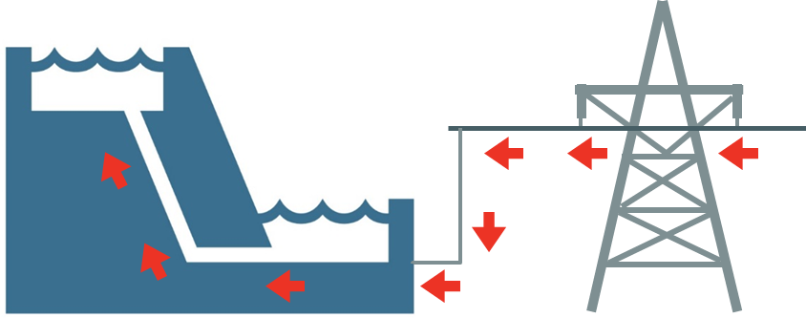
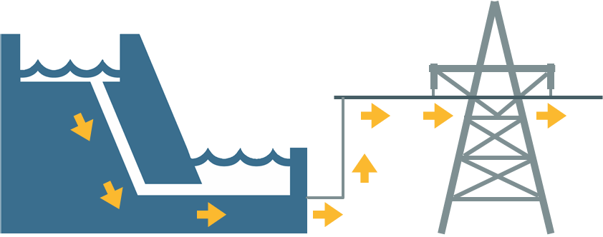
Pumped-Storage Hydro Operates in Binary Fashion
Reversible pump/turbine:
‒ Spins in one direction to pump water uphill (aka, charging)
‒ Stops and takes time to spin in reverse to generate electricity (aka, discharging)
Has two corresponding asset types modeled in ISO system and participating in markets:
‒ Charging: Dispatchable asset-related demand (DARD) submits bids to consume energy
‒ Discharging: Generator asset offers to supply energy and provide regulation
OR

Slide 12
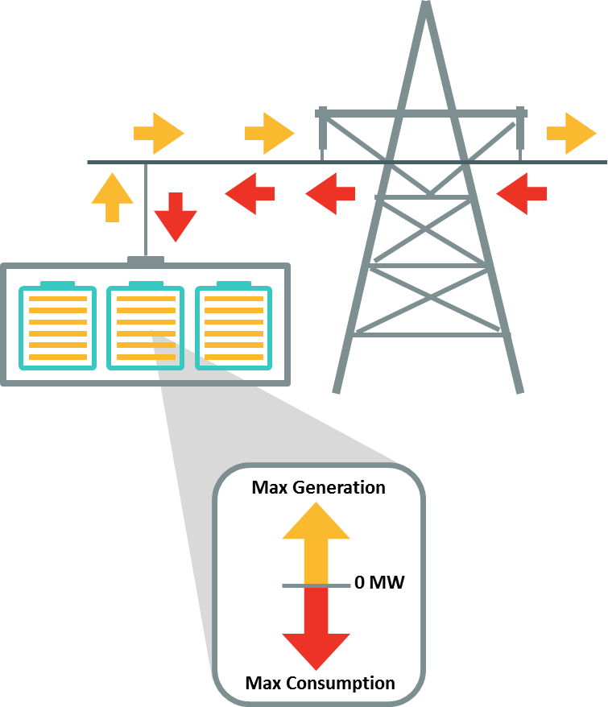
New Storage Technologies Operate in Continuous Fashion
Batteries and similar technologies can:
Move continuously and nearly instantaneously between charging and discharging in continuous range of generation and consumption
Set regulation range that crosses zero and can provide regulation while charging
or discharging
Slide updated on 11/17/2025.

Slide 13
Expanding Options for Storage in New England
March 2015—Regulation Market Redesign | April 1, 2019—Enhanced Storage Participation Revisions
Energy-neutral regulation dispatch signal for storage participating as alternative technology regulation resources (ATRRs) | (aka, Energy Storage Device Project) Introduces electric storage facility rules for: Binary storage facilities (i.e., pumped-storage hydro) Continuous storage facilities (e.g., batteries) Storage facilities as small as 1 MW can participate
June 2018—Price-Responsive Demand Project | December 2019—Additional revisions include:
Enabled demand response to participate in energy market as dispatchable resource and provide reserves | Any technology can participate under binary storage facility rules Electric storage facilities as small as 0.1 MW can participate Electric storage facilities may be exempted from Schedule 9 (regional network service) charges when consuming

Slide 14
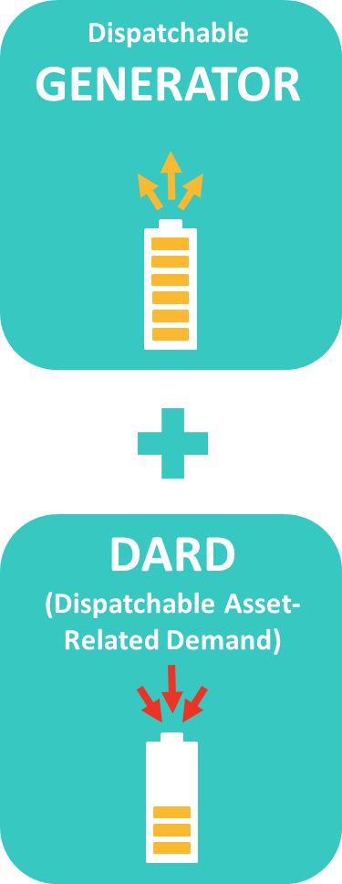
What Are Electric Storage Facilities?
In New England markets, this means storage facilities that:
Have ability to inject at least 0.1MW and consume at least 0.1 MW
Massachusetts storage facilities may participate in the SMART program
Register as and follow rules for both:
‒ Dispatchable generator asset
‒ Dispatchable asset-related demand (DARD)
Qualify as one of two subtypes:
‒ Binary storage facility (i.e., pumped storage)
‒ Continuous storage facility (e.g., batteries)
Can simultaneously participate in energy, reserves, and regulation markets
Slide updated on 11/17/2025.
MR1, Section III.1.10.6

Slide 15
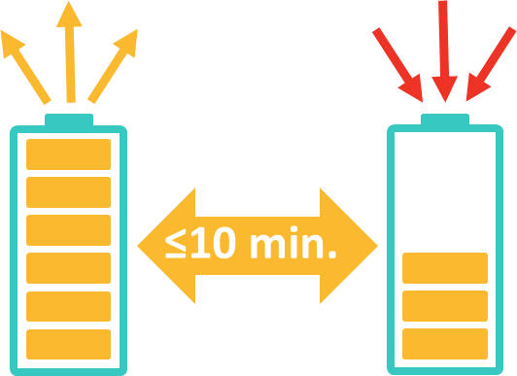
Qualifying as a Continuous Storage Facility (CSF)
In addition to general electric storage facility requirements, CSFs must be capable of max output to max consumption in ≤10 minutes
MR1, Section III.1.10.6

Slide 16
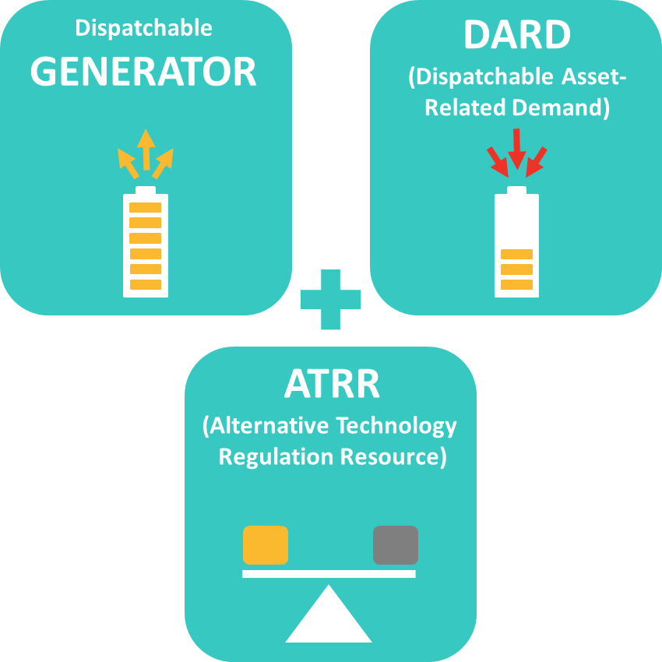
Qualifying as a Continuous Storage Facility (CSF), continued
CSFs must also register as ATRR:
Must all be same equipment
Can’t use storage capability shared with another generator asset, DARD, or ATRR
Not required to actually provide regulation
MR1, Section III.1.10.6

Slide 17
Questions?
CILBPU EN-ISO
Coming Up:
Market Participation by Continuous Storage Facilities
Initial Modeling, Technical Requirements, and Asset Registration
eMarket Requirements
Examples
Settlement and Billing Impacts
Additional Resources
ISO-NE PUBLIC

Slide 18
Market Participation by Continuous Storage Facilities
ISO-NE PUBLIC

Slide 19
New England’s Wholesale Electricity Market
Day-Ahead Energy Market
Produces financially binding schedules for production and consumption of electricity day before operating day
Energy
System for purchasing and selling electricity using supply and demand to set price
Market
Real-Time Energy Market
Balances differences between day-ahead scheduled amounts of electricity and actual real-time requirements
Reserve
Resources available to respond within 10- and 30-minutes to meet demand under certain contingencies; includes Forward Reserve and Real-Time Reserve Markets
Wholesale Electricity Market
Ancillary Services
Services that ensure reliability of production and transmission of electricity
Market
Regulation
Resources increase or decrease output every four seconds in response to signals from ISO to balance supply levels with second-to-second variations in demand
Voltage Support
Provide reactive power for voltage control and support
Forward
Capacity
Forward market where resources are compensated for delivery of capacity in three years’ time
Market
Blackstart
Support restoration of power system after partial or complete shutdown of system

Slide 20
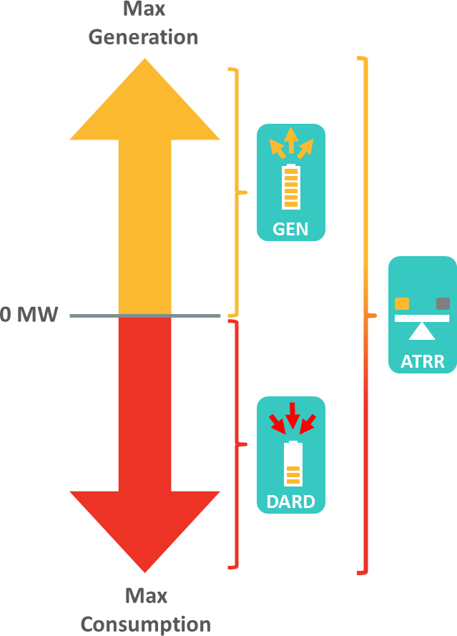
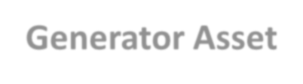
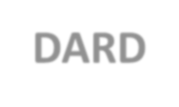
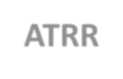

Different Asset Types Correspond to Different Abilities and Markets
A CSF’s three asset types enable simultaneous participation in energy, reserves, and regulation markets
Each asset responsible for different operating activity
Generator Asset | DARD | ATRR
Used to inject energy into grid and provide reserves | Used to manage energy consumed and reserves | Used to manage regulation (positive or negative)
CSFs cannot participate as demand response; must be directly metered, with no load behind same meter
MR1, Section III.1.10.6

Slide 21
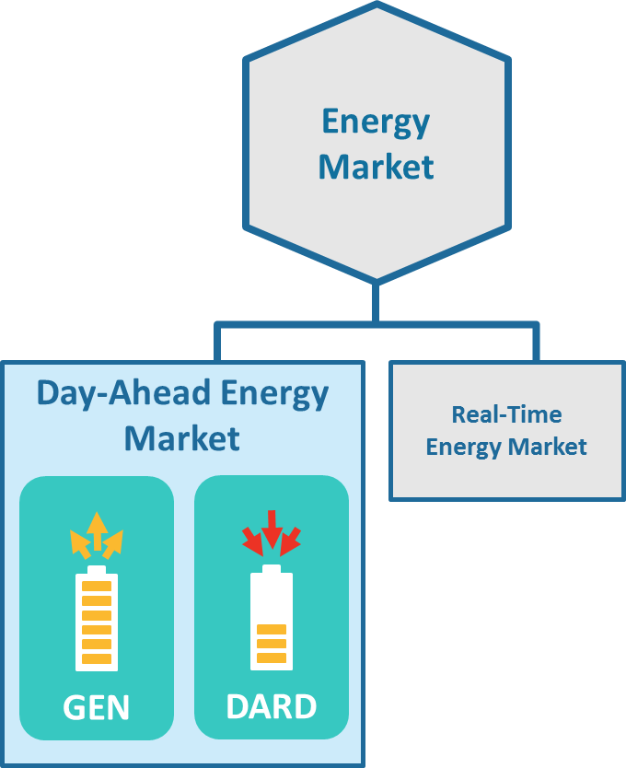
Day-Ahead Energy Market
CSF’s generator and DARD assets may participate
‒ CSF’s generator asset required to offer in if they have capacity supply obligation through Forward Capacity Market
Both generator asset and DARD always committed online at 0 MW, unless participant declares it unavailable in eMarket
‒ Each CSF asset must be online and operational unless declared unavailable

Slide 22
Day-Ahead Energy Market, continued
Dispatch level based on offers and economics, with each asset receiving:
‒ Independent dispatch MW level when cleared
‒ Zero when not cleared
Participant is responsible for developing day-ahead bids and offers so that CSF does not get day-ahead obligation to charge and discharge at same time. ISO day-ahead software will not check this for you.
!

Slide 23
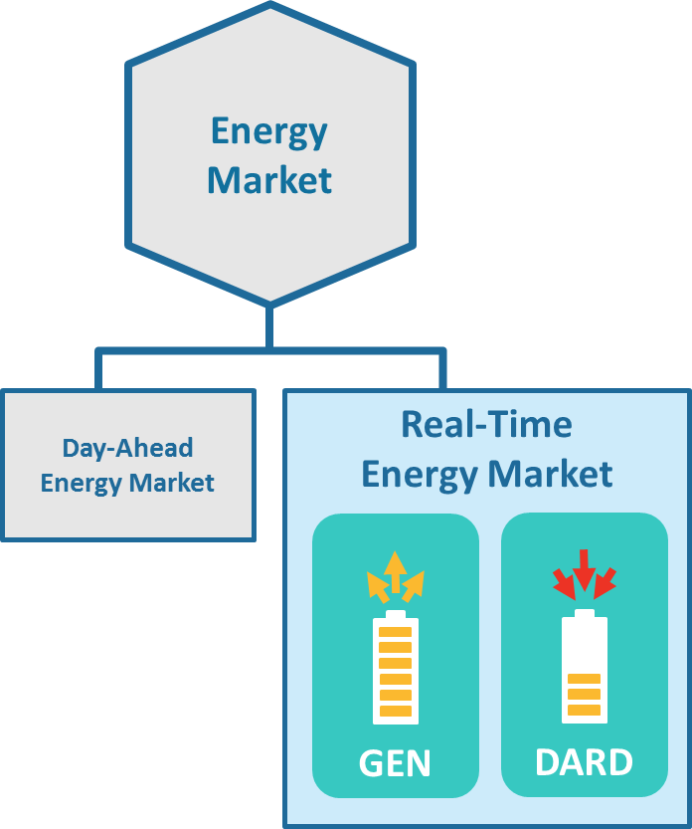
Real-Time Energy Market
Assets must self-schedule and be operational and online, unless declared unavailable
CSFs must telemeter key inputs to ISO via remote terminal unit (RTU),
including available MWhs of energy and available MWhs of storage.
!
See RTU and telemetry requirements in ISO‐NE Operating Procedures No. 18 (OP 18): Metering and Telemetering Criteria.

Slide 24
Real-Time Energy Market, continued
CSF assets dispatched based on charge status:
‒ When fully discharged (i.e., available energy = 0 MWh) only DARD is available for dispatch
‒ When fully charged (i.e., available storage = 0 MWh) only generator asset is available for dispatch
‒ When partially charged or discharged, dispatch based on offer parameters, availability status, and dispatch limits economically
Dispatch limits updated based on telemetered
available energy and storage

Slide 25
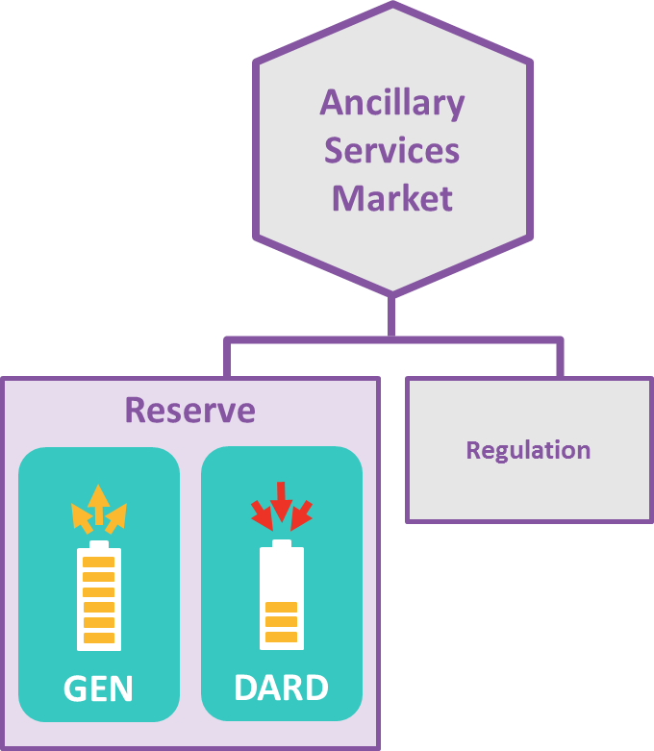
Reserve Markets
CSF can provide 10-minute spinning reserves
with generator asset and DARD, not ATRR
‒ Generator asset: reserves counted from current MW to economic max parameter
Economic max may be recalculated by system to meet reliability requirements based on telemetered output (details on later slide)
Participant required to bid Eco Min at 0 MW
‒ DARD asset: reserves counted from current MW to
Minimum Consumption parameter
Based on absolute value of telemetered output
Participant required to bid Min Consumption at 0 MW

Slide 26
Reserve Markets, continued
CSFs do not provide:
‒ Offline 10-minute nonspinning reserves (aka, CLAIM10)
‒ Offline 30-minute operating reserve (aka, CLAIM30)
This is due to requirement to always be operational and on line, unless declared unavailable

Slide 27
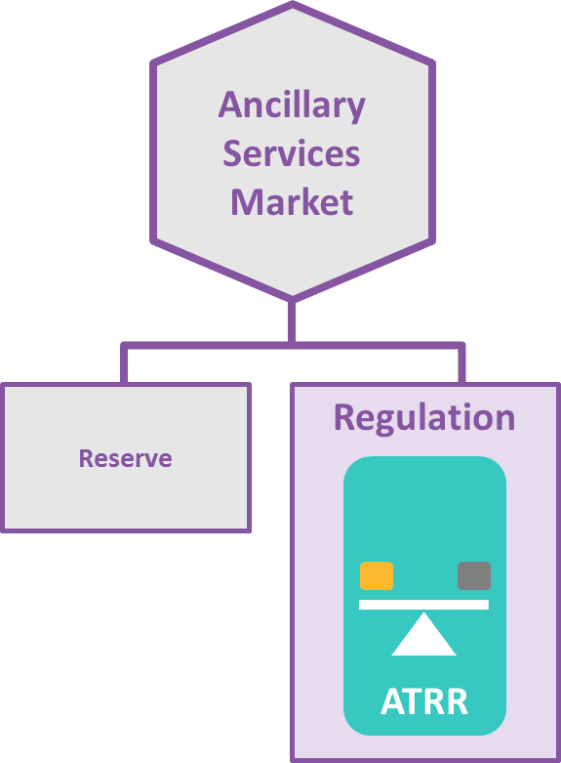
Regulation Market
CSF’s ATRR asset can participate in Regulation Market in real time
Average net energy consumption for ATRR generally around 0 MWh because:
‒ ATRR regulates via an energy neutral signal
‒ Regulation limits must be set close to symmetric limits around 0 MW
Can include small bias towards charging to account
for efficiency loss

Slide 28
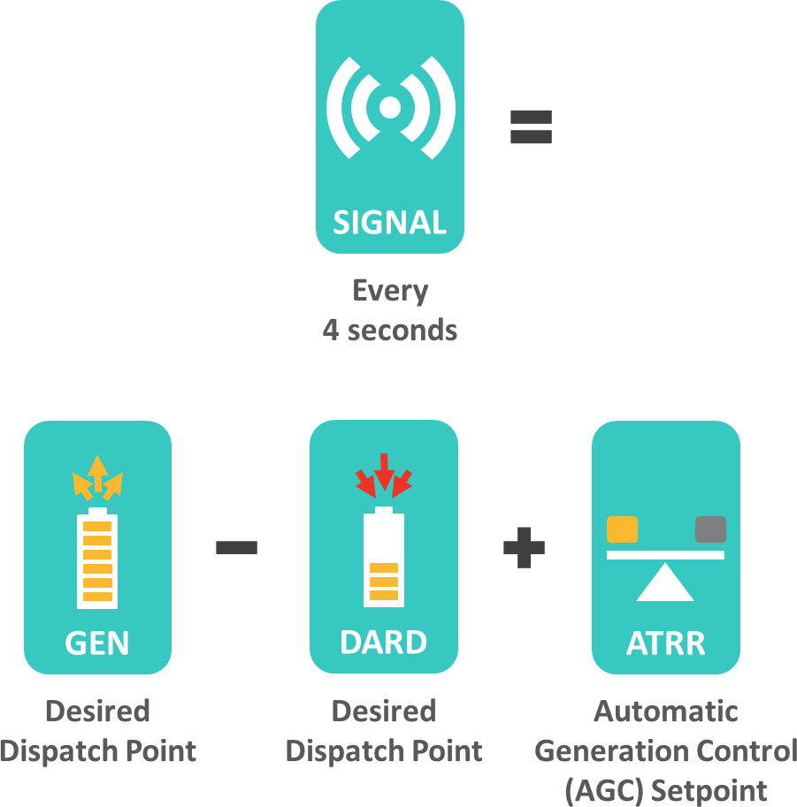
Simultaneous Dispatch of CSF
Dispatch software treats CSF as three different assets, and calculates separate dispatch signal for each
CSF gets single dispatch signal equal to:
‒ Desired dispatch point of generator asset
Generating output level to which they are expected to move
‒ Minus desired dispatch point of DARD
Amount to reduce consumption from
adjusted baseline
‒ Plus AGC setpoint of ATRR
Signal sent at 4 second intervals
MR1, Section III.1.10.6

Slide 29

Example of Simultaneous Dispatch
10
10 MW
5
Individual Dispatch
0
6 MW
Energy
4 MW
-5
Gen
-10
Regulation Signal
Generator DDP
DARD DDP
8 MW
Regulation
ATRR
10
5
Single Dispatch Signal
−4 MW
DARD
0
6 MW
Energy
-5
−10 MW
-10
EcoMax
Max Consump
Reg High
Reg Low
Dispatch Signal

Slide 30
Questions?
CILBPU EN-ISO
Coming Up:
Initial Modeling, Technical Requirements, and Asset Registration
eMarket Requirements
Examples
Settlement and Billing Impacts
Additional Resources
ISO-NE PUBLIC

Slide 31
Initial Modeling, Technical Requirements, and Asset Registration
Market Integration Process
Jacques Asselin
Lead Analyst, Asset Registration & New Generation Coordination
ISO-NE PUBLIC

Slide 32





Market Integration Process
Once the interconnection study is complete, the coordinated market integration process may begin
There's a similar process for projects regardless of technology type
Market Integration Process
Project Kickoff Meeting
Assign Market Participant Roles
Assign Designated Entity and RTU
Submit Technical Documents
Add to Power System Model
Interconnection
Register Asset
Slide updated on 11/17/2025.

Slide 33

The Interconnection Process
Before pursuing market participation, you must complete or be near completion of the interconnection process
‒ If required to follow the ISO New England interconnection process, you must have at least:
Interconnection Study (System Impact Study) completed
Proposed Plan Application (PPA) submitted
‒ Some facilities must follow the state interconnection process instead, which still requires a study to be completed and a PPA submitted.
Per FERC Order No. 2003-A, “Facilities subject to the [open access transmission tariff] are: transmission facilities used to transmit electric energy in interstate commerce either at wholesale or for unbundled retail sales; and ‘distribution’ facilities that are used for wholesale sales in interstate commerce.”
Slide updated on 11/17/2025.

Slide 34


ISO New England vs. State Interconnection Process Overview
Is project interconnecting to ISO-administered transmission system
(pool transmission facility [PTF], non-PTF, and FERC-jurisdictional distribution)?
‒ If YES, see #2
‒ If NO, use state interconnection process
Contact distribution company/owner of state-jurisdictional distribution facility
Is project exempt?
Exemptions:
Retail customer interconnecting new generating facility whose energy will ONLY be consumed at retail customer’s site
New generating facility connected to distribution facility subject to ISO Tariff, IF generating facility will not be used to make wholesale sales of electricity in interstate commerce
Qualifying facility defined by PURPA, where facility’s owner intends to sell all output to its interconnected electric utility
‒ If YES, use state interconnection process
‒ If NO, use ISO interconnection process
See ISO’s New or Modified Interconnections webpage
Slide updated on 11/17/2025.
For details, see Distribution-Connected Generation Guidance presentation

Slide 35




Market Integration: Project Kickoff Meeting
Should be scheduled 12–15 months in advance of targeted commercial operation date
‒ Contact ISO via Ask ISO or NewGenCoord@iso-ne.com
Meeting will review action items for market integration
‒ Process outlined in New Generation Projects: Process Guide
Project Kickoff Meeting
Assign Market Participant Roles
Add to Power System Model
Assign Designated Entity and RTU
Submit Technical Documents
Register Asset
Slide updated on 11/17/2025.

Slide 36


Market Integration: Assign Market Participant Roles
Specify which market participants will play required roles related to CSFs
‒ Can be same or different market participants
Each role has different responsibilities for:
‒ Scheduling and bidding assets to market
‒ Wholesale settlement obligation (regulation, energy, reserves)
‒ Forward Capacity Market
Assign Market Participant Roles
Add to Power System Model
Project Kickoff Meeting
Assign Designated Entity and RTU
Submit Technical Documents
Register Asset
Slide updated on 11/17/2025.

Slide 37



Market Participant Roles and Responsibilities for CSFs
Continuous Storage Facility
ASSET
Lead Market Participant
RESOURCE
Lead Market Participant
FCTS
eMarket
Forward Capacity Tracking System
Designated Entity
DISPATCH
Capacity Product
$
SETTLEMENTS
GEN
ATRR
DARD
Roles can be filled by the same or different market participants
Owner(s)
RESOURCE Lead
Market Participant

Slide 38

Market Participant Roles and Responsibilities for CSFs, continued
Asset Lead Market Participant
eMarket
Single settleable market participant
Responsible for:
Technical documentation and market compliance
Day-to-day offers and bidding of CSF assets in eMarket for
energy (injections and withdrawals), reserves, and regulation
$
SETTLEMENTS
Asset owner(s)
‒ Incurs settlement obligation for:
Generator asset (energy injections)
ATRR (regulation)
DARD (energy withdrawals)
Roles can be filled by the same or different market participants
Designated entity and RTU
‒ Handles dispatch communications
DISPATCH

Slide 39
Market Participant Roles and Responsibilities for CSFs, continued
Resource Lead Market Participant:
‒ Single entity
‒ May be one of the market participants associated with the asset OR another market participant
‒ Responsible for capacity market-related
Administrative functions
Capacity Supply Obligation
Capacity Product
More information on capacity market:
‒ FCM Participation Guide

Slide 40


Market Integration: Assign Designated Entity (DE) and RTU
The Designated Entity (DE) is responsible for 24/7 dispatch communications with the ISO-NE Control Room
‒ Must have equipment dedicated to ISO New England
‒ If not, allow at least 90 days to order/deliver/install:
ISO validates assigned (DE) Dispatch Location and coordinates registration, if needed
Remote terminal unit (RTU)
Electronic dispatch circuits/router
Exclusive phone line (Dedicated Bell Line)
Project Kickoff Meeting
Assign Market Participant Roles
Assign Designated Entity and RTU
Submit Technical Documents
Add to Power System Model
Register Asset
Slide updated on 11/17/2025.

Slide 41

Market Integration: Submit Technical Documents
See requirements in ISO‐NE operating procedures (OPs):
No. 12 (OP 12): Voltage and Reactive Control
No. 14 (OP 14): Technical Requirements For Generators, Demand Response Resources, Asset Related Demands, and Alternative Technology Regulation Resources
No. 16 (OP 16): Transmission System Data (if necessary)
No. 18 (OP 18): Metering and Telemetering Criteria
‒ Required NX technical data forms available on operating procedures webpage
‒ Separate technical data form required for each asset (GEN, ATRR, and DARD)
Submit Technical Docu- ments
Project Kickoff Meeting
Assign Market Participant Roles
Assign Designated Entity and RTU
Add to Power System Model
Register Asset
Slide updated on 11/17/2025.

Slide 42

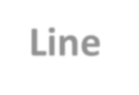
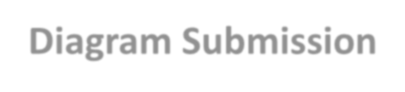




Market Integration: Add to Power System Model
Before operating, facility must be represented in the ISO-NE New England power system model
Requires submission of one-line diagram of facility in advance of scheduled model release, which happens 3 times a year in February, May, and September.
Deadlines for One-Line Diagram Submission
Submit by previous: | For inclusion in update of:
November | February
March | May
July | September
Add to Power System Model
Project Kickoff Meeting
Assign Market Participant Roles
Assign Designated Entity and RTU
Submit Technical Documents
Register Asset
Slide updated on 11/17/2025.

Slide 43


Market Integration: Register Asset
Submit request for continuous storage registration via Ask ISO
See Ask ISO user guide
2. A single registration form for all three assets will be required with the request.
Project Kickoff Meeting
Assign Market Participant Roles
Assign Designated Entity and RTU
Submit Technical Documents
Add to Power System Model
Register Asset
Slide updated on 11/17/2025.

Slide 44
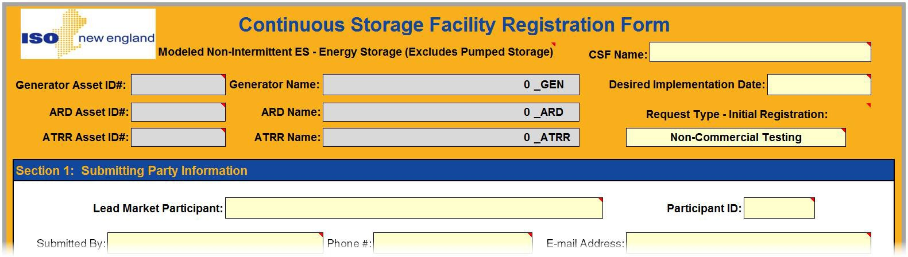
Registration Results in Three Separate Assets IDs
1
Asset Registration will confirm the facility name; must be unique and ≤25 characters
2
Suffixes automatically added to facility name to
represent each CSF asset: “_GEN” for generator asset; “_DARD” for DARD; and “_ATRR” for ATRR
MyFacility
MyFacility_GEN
MyFacility_DARD
MyFacility_ATRR
3
Asset IDs are generated by ISO-NE and reflected in eMarket
Slide updated on 11/17/2025.

Slide 45
Questions?
CILBPU EN-ISO
Coming Up:
eMarket Requirements
Examples
Settlement and Billing Impacts
Additional Resources
ISO-NE PUBLIC

Slide 46
eMarket Requirements
Rules for Managing Assets, Bids, and Offers
Tim Peet
Manager, Customer Support
ISO-NE PUBLIC

Slide 47
CSFs Must Follow Certain Rules in eMarket
Rules for managing availability, bids, and offers
‒ Rules relate to CSF registration and operating characteristics
Subsequent slides cover only CSF changes, not general eMarket usage
‒ To learn more about eMarket, see eMarket User Guide and
FAQs: Using eMarket
eMarket
Web services and upload/download protocols:
‒ For CSF asset types, same validation rules applied in XML
uploads/downloads as in eMarket user interface
‒ For more information, see Energy Storage Device (ESD) Project customer readiness webpage
!
There are no changes for
non-CSF resources
ISO-NE PUBLIC
47

Slide 48
Offer and Bid Data Requirements for CSFs
Values to be entered into eMarket application
To self-schedule and maintain continuous range of potential dispatch points,
CSF assets must specify 0 MW for:
‒ Economic minimum limit (generator asset’s lowest sustainable output level)
‒ Emergency minimum limit (generator asset’s minimum output deliverable for
limited period without exceeding stability limits and operating permits)
‒ Minimum consumption limit (DARD’s lowest available consumption level)
eMarket
Since CSF generator asset operates without temporal constraints or costs and isn’t part of commitment process, it must specify:
‒ 0 value for:
Notification time
Start-up time
Minimum run time
Minimum down time
‒ $0 for:
Start-up fee
No-load fee
MR1, Section III.1.10.6

Slide 49

Declaring Unavailability or Scheduling Outages
Continuous Storage Facility Must Operate in On-line State Unless Declared Unavailable
Setting Availability Status
Day ahead: participant sets status in eMarket to Must Run or unavailable
Real time:
‒ For generator asset and DARD, participant calls ISO control room to change availability
‒ For ATRR, participant can change offer status in eMarket each hour before Regulation Selector is run
Once ATRR is selected, must call ISO control room to change status
Outages
CSF generating asset must submit outages into CROW outage scheduler
‒ DARDs and ATRRs cannot schedule outages:
CSF Generators that have a CSO
Or are a Qualified Reactive Resource
Slide updated on 11/17/2025.

Slide 50
How Day-Ahead Asset Status Affects Real-Time Status
Day-ahead market:
‒ Participant can set Must Run or Unavailable status
independently for generator asset and DARD
ATRR doesn’t participate in Day-Ahead Energy Market
Real-time operations:
‒ For generator asset and DARD, if either is offered as Must Run, both are treated as available
Generator asset and DARD status always kept in synch
‒ ATRR’s status doesn’t impact them
‒ For ATRR, if generator and DARD are:
‒ Unavailable, ATRR also unavailable
‒ Must Run, ATRR can be either Must Run or Unavailable
‒ Participant must call ISO control room to change status in real time (see preceding slide)
Status Interplay
DAY AHEAD |  |  | REAL-TIME OPERATIONS
GEN | DARD |  | GEN | DARD | ATRR
 |  | · |  |  | or 
 |  | · |  |  | or 
 |  | · |  |  | or 
 |  | · |  |  | 
 = Must Run  = Unavailable

Slide 51
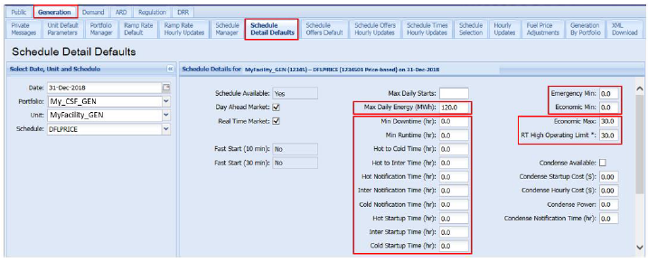

Key to eMarket Fields
WHITE FIELDS can be changed by participant
MyFacility_GEN
DARK FIELDS cannot
be changed
25.0
PINK FIELDS indicate data have not been saved yet or
are unacceptable (if accompanied by error message)
Slide updated on 11/17/2025.

Slide 52
Must Bid Ramp Rate That Allows the Unit to be Dispatched From EcoMax to MaxCons in < 10 Minutes
Unit Multiple Ramp Rates Daily Default
Unit Ramp Rates Hourly Updates
Slide updated on 11/17/2025.

Slide 53
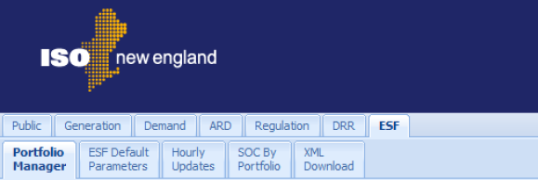
Manage Availability and Offers or Bids Separately for Each CSF Asset Type
Look for Appropriate Tab
3
Use to manage alternative technology
regulation resource (ATRR) asset
1
Use to manage
2 Use to manage dispatchable asset-
generator asset
related demand (DARD) asset
Remember, participant is responsible for developing day-ahead bids and offers so that CSF does not get day-ahead obligation to charge and discharge at same time. ISO day-ahead software will not check for this.
!
Slide updated on 11/17/2025.

Slide 54
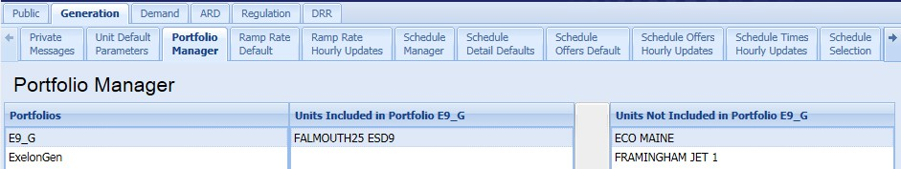
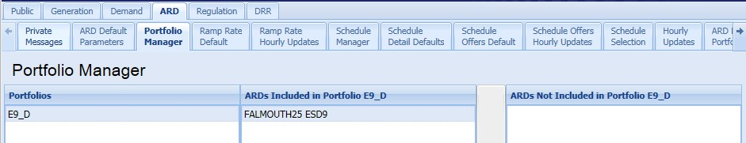
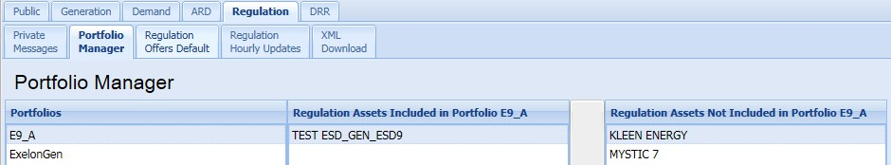
Portfolio Manager Tabs
Slide updated on 11/17/2025.
Start by Adding Each CSF Asset into Corresponding Portfolios
1
Add
MyFacility_GEN to generation portfolio
My_CSF_GEN
MyFacility_GEN
2
Add
MyFacility_ARD to asset-related demand portfolio
My_CSF_ARD
MyFacility_ARD
3
Add
MyFacility_ATRR to regulation portfolio
My_CSF_ATRR
MyFacility_ATRR

Slide 55
Questions?
CILBPU EN-ISO
Coming Up:
eMarket Requirements for CSF Generator Assets
Examples
Settlement and Billing Impacts
Additional Resources
ISO-NE PUBLIC

Slide 56
CSF Generator Asset
eMarket Rules for Continuous Storage Facilities

Slide 57
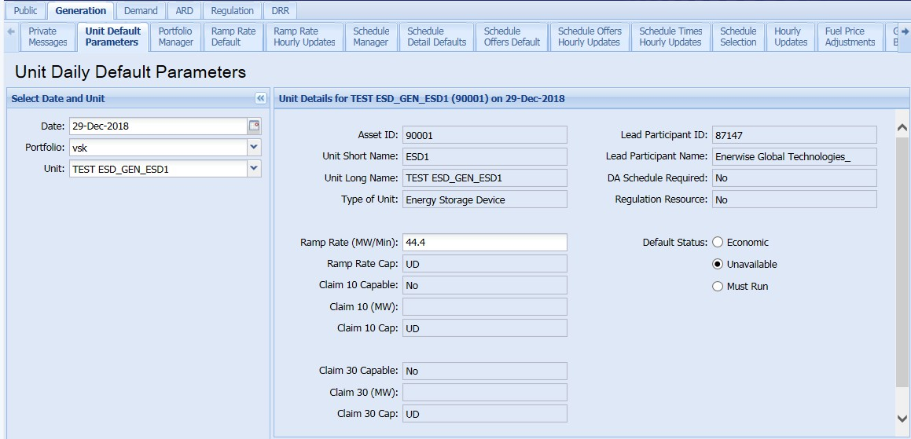

Generation Tab: Unit Default Parameters
Inputs Here Establish Default Values
MyFacility_GEN (12345) on 29-Dec-2018
4
Regulation only
12345
available with
My_CSF_GEN
MyFacility_ | GEN
ATRR asset
MyFacility_GEN
1 CSF generator asset
must be selected
100.0
2 Denotes a CSF (as would “ESD”)
5 Must be set to Must Run, unless unavailable
3
Unchangeable—CSFs ineligible for
offline reserves (“UD” = undefined)
Slide updated on 11/17/2025.

Slide 58
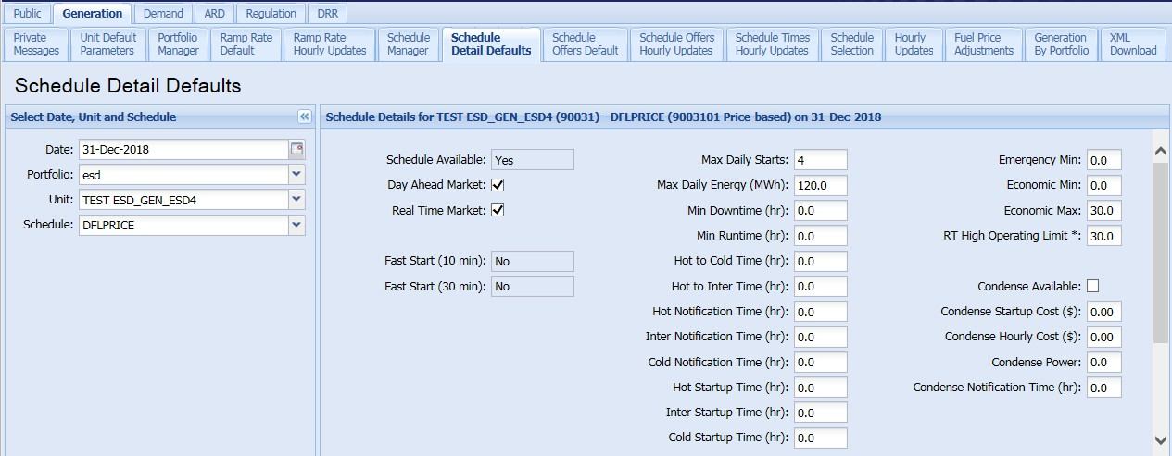
Generation Tab: Schedule Detail Defaults
Inputs Here Establish Default Values
3
Economic Min and Emergency
Min must be set to zero
MyFacility_GEN (12345) – DFLPRICE (1234501 Price-based) on 31-Dec-2018
My_CSF_GEN
MyFacility_GEN
1
Specify value to indicate limited
energy in day-ahead market and enable hourly LEG limits¹
2
Intertemporal parameters
must be set to zero
¹A Max Daily Energy value is the maximum amount of energy a unit can produce in one operating day, whereas a blank field means the value is unlimited. Specifying a value allows you to choose to operate as a limited-energy generator (LEG) in real time.
ISO-NE PUBLIC
57

Slide 59
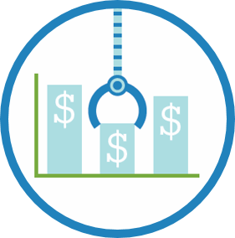
Limited Energy Generator (LEG) Option
Enter Maximum Daily Energy value (MWh) in Schedule Detail Defaults tab
Day ahead, software schedules limited energy in hours with greatest positive difference between locational marginal price and generator offer
In real time, two options:
Do nothing and operate as economic resource
Unit dispatched without consideration of Max Daily Energy value (e.g., energy may be depleted before day’s end)
ISO may posture resource to preserve capacity through peak hour, if necessary
Call ISO control room to activate LEG dispatch
Unit dispatched economically between CSF’s Eco Min of 0 MW and hourly LEG limit
‒ Participant can call in hourly LEG limit in advance (including 0 MW)
- While resource is LEG’d, still required to follow emergency dispatch instructions if issues, which could be higher than LEG
Slide updated on 11/17/2025.

Slide 60

Effective Economic Max
Participant can offer economic max in eMarket using daily default with hourly overrides
‒ Illustrated on Schedule Detail Defaults screenshot
But effective economic max may be different from offered economic max to comply with reliability requirement
‒ If a resource is participating in Reserves, and their available storage falls below 1 hour sustainability, their EcoMax will be redeclared to ensure sustainability for 1 hour.
- If a Resource is not participating in Reserves, their EcoMax is redeclared to ensure sustainability of 15 mins, which is the typical length of a normal dispatch interval.
Effective economic max is calculated in real time using telemetered available energy
Slide updated on 11/17/2025.

Slide 61
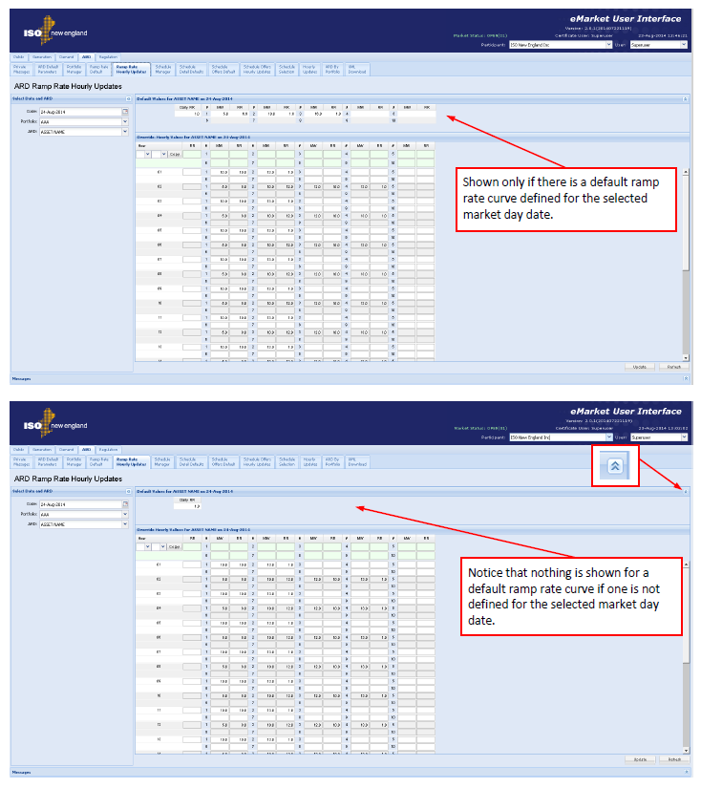
Must Bid Ramp Rate That Allows the Unit to be Dispatched From EcoMax to MaxCons in < 10 Minutes
ARD Multiple Ramp Rates Daily Default
Unit Ramp Rates Hourly Updates
Slide updated on 11/17/2025.

Slide 62
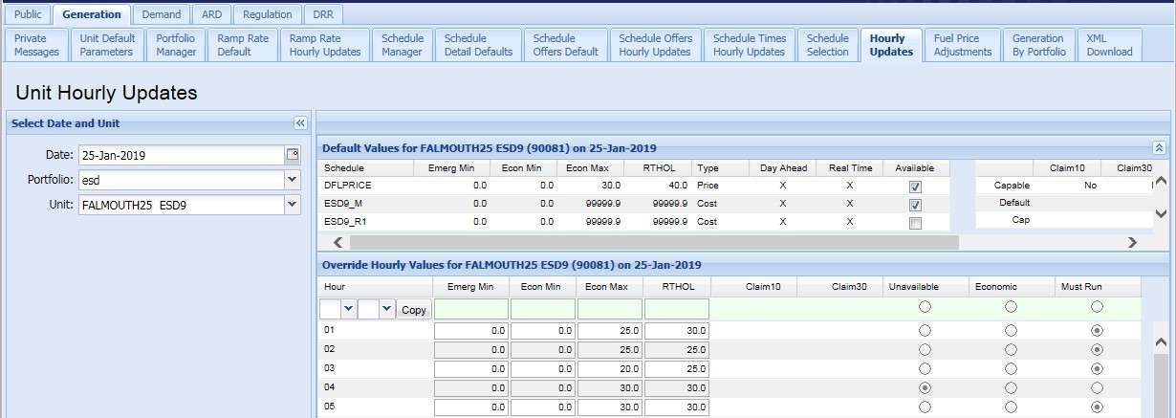
Generation Tab: Hourly Updates
Economic Max and Availability for CSF Generator Asset Can Be Set On an Hourly Basis to Override Default Values
MyFacility_GEN (12345) on 25-Jan-2019
My_CSF_GEN
MyFacility_GEN
MyFacility_GEN (12345) on 25-Jan-2019
0.0
0.0
Remember that Economic Min and Emergency Min must be set to zero
Slide updated on 11/17/2025.

Slide 63
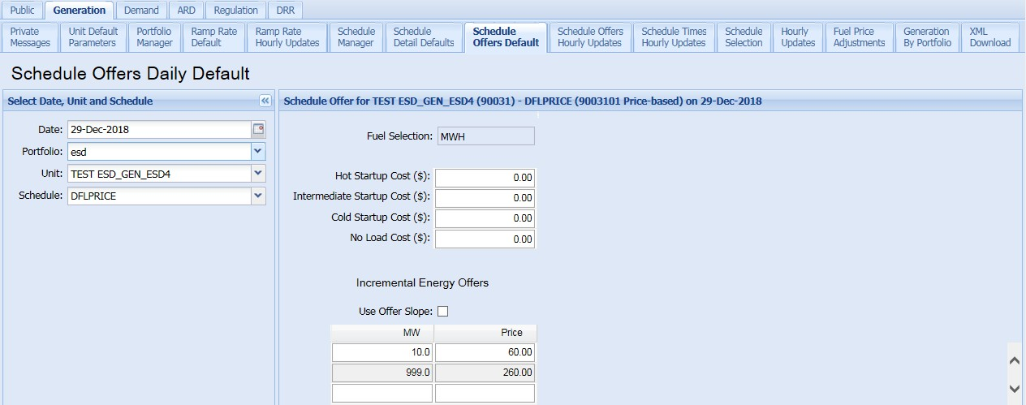
Generation Tab: Schedule Offers Default
MyFacility_GEN (12345) – DFLPRICE (1234501 Price-based) on 29-Dec-2018
My_CSF_GEN
MyFacility_GEN
Start Up and No Load Costs
must be set to zero
Slide updated on 11/17/2025.
61

Slide 64
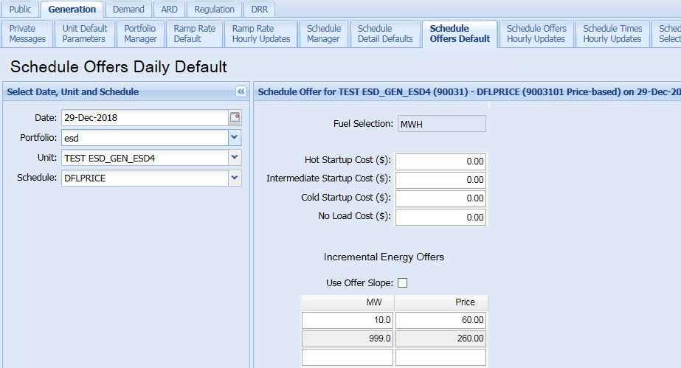

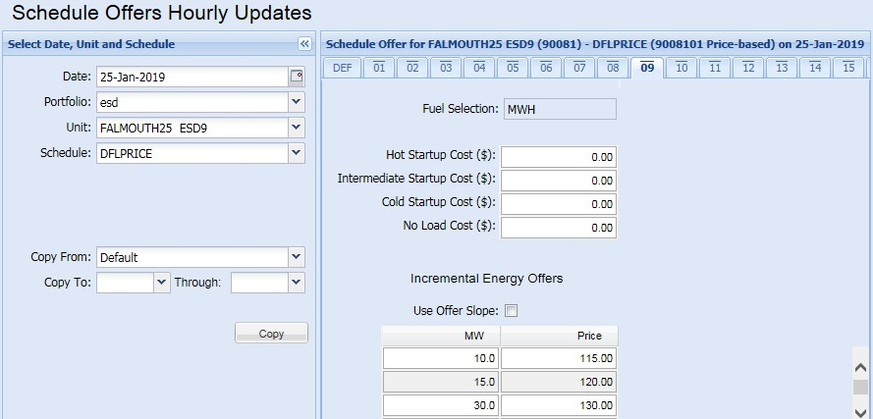
Generation Tab: Schedule Offer Hourly Updates
Offers Can Be Set on an Hourly Basis to Override Default Values
Schedule Offers Hourly Updates
MyFacility_GEN (12345) – DFLPRICE (1234501 Price-based) on 29-Dec-2018
My_CSF_GEN
MyFacility_GEN
Start Up and No Load
Costs must be set to zero
Slide updated on 11/17/2025.

Slide 65
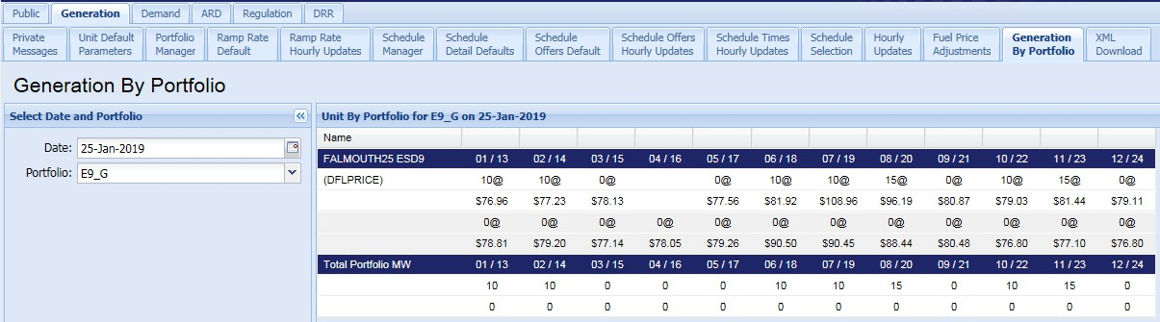
Generation Tab: Generation by Portfolio
Portfolio Clearing Results in Day-ahead Energy Market Based on Economics and CSF Generator Asset Availability
MyFacility_GEN on 25-Jan-2019
My_CSF_GEN
MyFacility_GEN
Slide updated on 11/17/2025.

Slide 66
Questions?
CILBPU EN-ISO
Coming Up:
eMarket Requirements for CSF DARDs and CSF ATRRs
Examples
Settlement and Billing Impacts
Additional Resources
ISO-NE PUBLIC

Slide 67
CSF DARD Asset
eMarket Rules for Continuous Storage Facilities

Slide 68
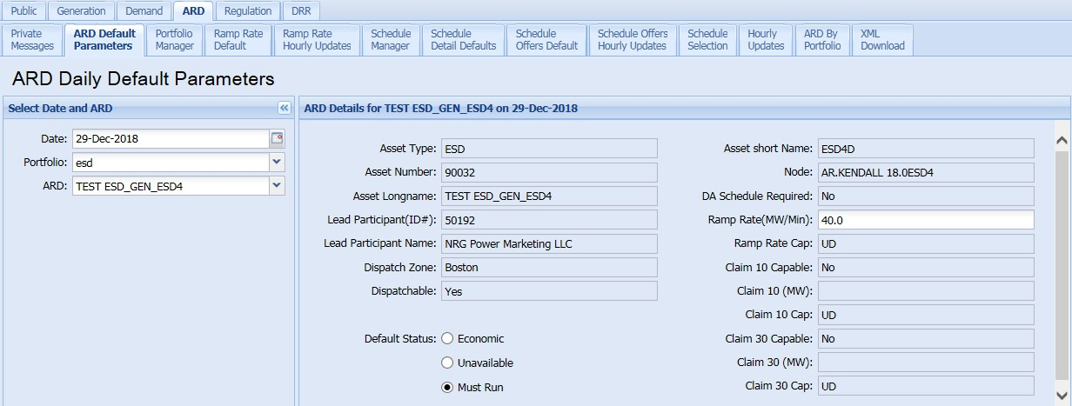
ARD Tab: ARD Default Parameters
Inputs Here Establish Default Values
3
Unchangeable—
CSFs ineligible for offline reserves
MyFacility_ARD (12345) on 29-Dec-2018
CSF_ARD
(“UD” = undefined)
My_CSF_ARD
MyFacility_ | ARD
12345
MyFacility_ARD
1
CSF DARD asset
100.0
must be selected
2
Must be set to Must Run,
unless unavailable
Slide updated on 11/17/2025.

Slide 69
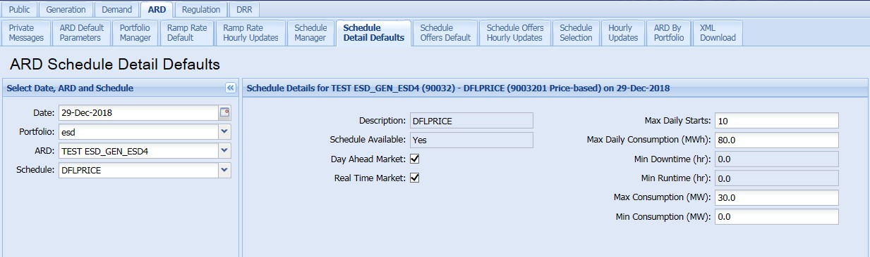
ARD Tab: Schedule Detail Defaults
Inputs Here Establish Default Values
1
Specify maximum energy to be
consumed in day-ahead market
MyFacility_ARD (12345) – DFLPRICE (1234501 Price-based) on 29-Dec-2018
My_CSF_ARD
MyFacility_ARD
2
Must be set
to zero
Slide updated on 11/17/2025.

Slide 70
Effective Consumption Max
Similar to Effective Economic Max Discussed Previously for CSF Generator Asset
Participant can offer max consumption in eMarket using daily default with hourly overrides
‒ Illustrated on Schedule Detail Defaults screenshot
But effective max consumption may differ from offered max consumption to ensure sustainability for ≥15 minutes
‒ Necessary to comply with economic dispatch period
Effective max consumption is calculated in real time using participant’s telemetered available storage

Slide 71
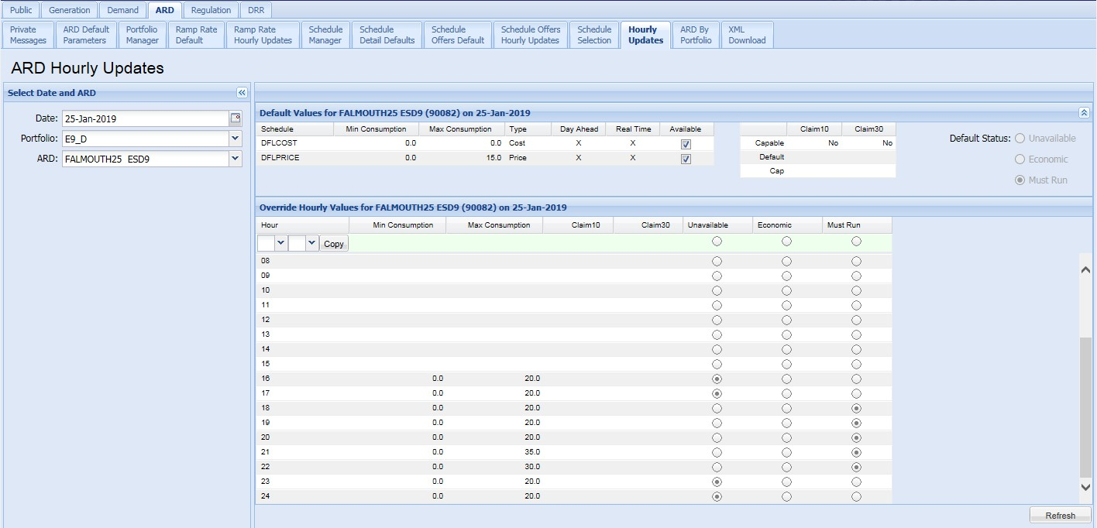
ARD Tab: Hourly Updates
Max Consumption and Availability for CSF DARD Can Be Set on an Hourly Basis to Override Default Values
MyFacility_ARD (12345) on 25-Jan-2019
My_CSF_ARD
MyFacility_ARD
MyFacility_ARD (12345) on 25-Jan-2019
0.0
0.0
0.0
0.0
0.0
0.0
0.0
0.0
0.0
0.0
0.0
0.0
0.0
0.0
Remember that Min Consumption
must be set to zero
0.0
0.0
Slide updated on 11/17/2025.

Slide 72
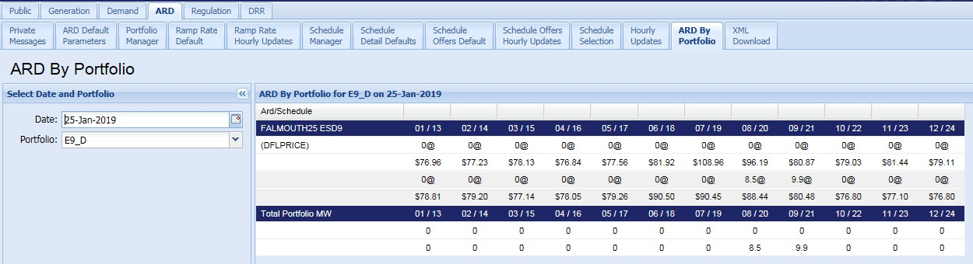
ARD Tab: ARD by Portfolio
Clearing Results in Day-Ahead Energy Market Based on Economics and DARD Availability
MyFacility_ARD on 25-Jan-2019
My_CSF_ARD
MyFacility_ARD
Slide updated on 11/17/2025.

Slide 73
Questions?
CILBPU EN-ISO
Coming Up:
eMarket Requirements for CSF ATRRs
Examples
Settlement and Billing Impacts
Additional Resources
ISO-NE PUBLIC

Slide 74
CSF ATRR Asset
eMarket Rules for Continuous Storage Facilities

Slide 75
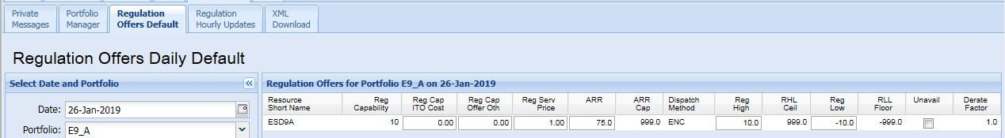
Regulation Tab: Regulation Offers
Use to Set CSF ATRR’s Daily Availability and Regulation Limits
1 Reg High and Reg Low values specify offered regulation range
2 Sets operating-day availability
My_CSF on 26-Jan-2019
My_CSF_ATRR
CSF_ATRR
Slide updated on 11/17/2025.

Slide 76
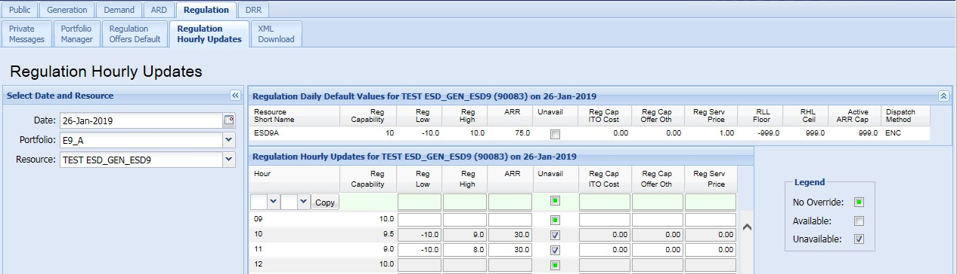
Regulation Tab: Regulation Hourly Updates
Use to Set CSF ATRR’s Hourly Overrides for Availability and Regulation Limits
MyFacility_ATRR (12345) on 26-Jan-2019
My_CSF_ATRR
CSF_ATRR
MyFacility_ATRR
MyFacility_ATRR (12345) on 26-Jan-2019
1 Reg High and Reg Low values
specify offered regulation range
2 Sets hourly
availability
Slide updated on 11/17/2025.

Slide 77
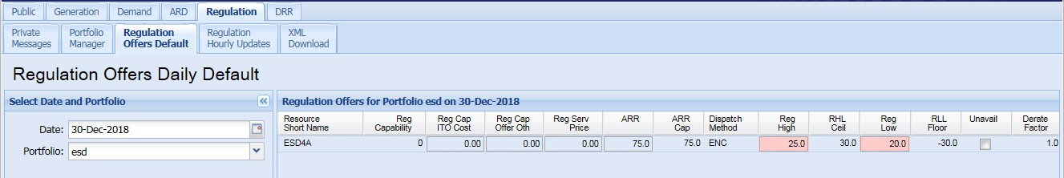
New Mid-Point Limit Validation Rule
Only Applies to CSF ATRR
ATRR’s average net consumption of 0 MW allows ISO to dispatch CSF generator or DARD asset for energy while ATRR simultaneously provides regulation
To accomplish this:
‒ Regulation range (i.e., Reg High and Reg Low) must be symmetrical or biased slightly to charging
‒ System validation ensures range doesn’t exceed maximum or minimum mid-point limit
Limit will be made available
Rule applies to both daily and hourly regulation limits
My_CSF on 30-Dec-2018
CSF_ATRR
10.0
−10.0
My_CSF_ATRR
ESD1

Slide 78
Error Example: Exceeding MAX Midpoint Limit
Error Must Be Cleared to Submit Offer
My_CSF on 30-Dec-2018
My_CSF_ATRR
CSF_ATRR
10.0
−8.0
ESD_ATRR Reg Limit Mid-Point Per-Unit [0.1] cannot be greater than the ISO set value for MAX Reg Mid-Point Per-Unit [0.0]. Offered limits are:
Reg Low [−8] Reg High [10]
If Reg Limit Mid-Point > Max Reg Mid-Point = ERROR
Mid-point of regulation range = (Reg High + Reg Low) ÷ 2 = (10 + −8) ÷ 2 = 1.0
Reg Limit Mid-Point = mid-point of regulation range ÷ the greater of the absolute value of Reg High and the absolute value of Reg Low = 1 ÷ 10 = 0.1
Max Reg Limit Mid-Point for this unit (set by ISO) = 0.0
4.
0.1 > 0.0 = ERROR
Slide updated on 11/17/2025.
ISO-NE PUBLIC

Slide 79
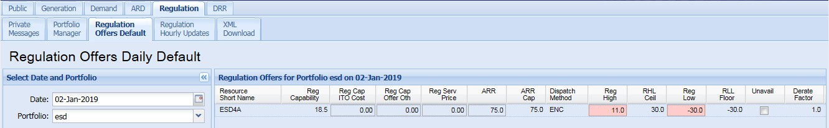
Error Example: Falling Below MIN Midpoint Limit
Error Must Be Cleared to Submit Offer
My_CSF on 02-Jan-2019
My_CSF_ATRR
CSF_ATRR
10.0
−16.0
ESD_ATRR Reg Limit Mid-Point Per-Unit [−0.1875] cannot be less than the ISO set value for MIN Reg Mid-Point Per-Unit [−0.15]. Offered limits are:
Reg Low [−16] Reg High [10]
If Reg Limit Mid-Point < Min Reg Mid-Point = ERROR
Mid-point of regulation range = (Reg High + Reg Low) ÷ 2 = [10 + −16] ÷ 2 = −3
Reg Limit Mid-Point = mid-point of regulation range ÷ greater of the absolute value of Reg High and the
absolute value of Reg Low = −3 ÷ 16 = −0.1875
Min Reg Mid-Point for this unit (set by ISO) = −0.15
−0.1875 < −0.15 = ERROR
Slide updated on 11/17/2025.
ISO-NE PUBLIC

Slide 80
Examples
How Continuous Storage Facilities Could Offer or Bid into Markets
ISO-NE PUBLIC

Slide 81

Example 1
Default Offers Are Used for Day-Ahead Commitment of Generator Asset and DARD
12 MW
MyFacility_GEN
MyFacility_ARD
Max Consumption (MW): | 12
Max Daily Consumption (MWh): | 12
 | MW | Price
Incremental Energy Offer: | 12 | $15
1
Participant specifies daily max
Economic Max (MW): 12 Max Daily Energy (MWh): 10
values; do not have to match
MW Price
Incremental Energy Offer: 12
$30
2
10 MWh from generator asset and 12 MWh from DARD
are committed based on market clearing
Clearing in Day-Ahead Energy Market
Asset | Hourly Interval
 | 1 | 2 | 3 | 4 | 5 | 6 | 7 | 8 | 9 | 10 | 11 | 12 | 13 | 14 | 15 | 16 | 17 | 18 | 19 | 20 | 21 | 22 | 23 | 24
LMP ($/MWh) | $15 | $15 | $15 | $15 | $15 | $20 | $25 | $30 | $30 | $30 | $30 | $25 | $25 | $25 | $30 | $35 | $35 | $30 | $25 | $25 | $20 | $20 | $15 | $15
MyFacility_GEN | 0 | 0 | 0 | 0 | 0 | 0 | 0 | 1 | 1 | 1 | 1 | 0 | 0 | 0 | 2 | 4 | 0 | 0 | 0 | 0 | 0 | 0 | 0 | 0
MyFacility_ARD | 2 | 3 | 3 | 1 | 1 | 0 | 0 | 0 | 0 | 0 | 0 | 0 | 0 | 0 | 0 | 0 | 0 | 0 | 0 | 0 | 0 | 0 | 1 | 1
ISO-NE PUBLIC

Slide 82
Example 2
Participant Strategically Offers and Bids Day Ahead with Goal of Alternating Discharging and Consumption
12 MW
MyFacility_GEN
1
Participant sets daily max values so
MyFacility_ARD
Economic Max (MW):
12
to limit each asset to 12 hours of
operation (12 MW x 5 hrs = 60 MWh)
Max Consumption (MW):
12
Max Daily Energy (MWh):
60
Max Daily Consumption (MWh):
60
2
Participant staggers low and high offers and bids. (Low generator asset offers signal desire to generate, while low DARD bids signal
_{Hourly Updates} desire not to consume. Conversely, high generator asset offer signals desire not to generate, while high DARD bid signals desire to consume.)
Asset |  | Hourly Interval
 |  | 1 | 2 | 3 | 4 | 5 | 6 | 7 | 8 | 9 | 10 | 11 | 12 | 13 | 14 | 15 | 16 | 17 | 18 | 19 | 20 | 21 | 22 | 23 | 24
MyFacility_GEN | MW | 0 | 0 | 0 | 0 | 0 | 0 | 0 | 0 | 0 | 0 | 0 | 0 | 12 | 12 | 12 | 12 | 12 | 0 | 0 | 0 | 0 | 0 | 0 | 0
 | Price | 100 | 100 | 100 | 100 | 100 | 100 | 100 | 100 | 100 | 100 | 100 | 100 | −150 | −150 | -150 | -150 | -150 | 100 | 100 | 100 | 100 | 100 | 100 | 100
MyFacility_ARD | MW | 12 | 12 | 12 | 12 | 0 | 0 | 0 | 0 | 0 | 0 | 0 | 0 | 0 | 0 | 0 | 0 | 0 | 0 | 0 | 0 | 0 | 0 | 0 | 0
 | Price | 50 | 50 | 50 | 50 | 50 | -150 | -150 | -150 | -150 | -150 | -150 | -150 | -150 | -150 | -150 | -150 | -150 | -150 | -150 | -150 | -150 | -150 | -150 | -150
Clearing in Day-Ahead Energy Market 3 Market clears with 60 MWh spread across each asset’s 5 economic hours
Asset |  | Hourly Interval
 |  | 1 | 2 | 3 | 4 | 5 |  | 6 | 7 | 8 | 9 | 10 | 11 | 12 | 13 | 14 | 15 | 16 | 17 | 18 | 19 | 20 | 21 | 22 | 23 | 24
 | LMP ($/MWh) | $20 | $20 | $10 | $10 | $20 |  | $22 | $25 | $27 | $30 | $30 | $30 | $25 | $30 | $35 | $29 | $25 | $35 | $35 | $20 | $20 | $20 | $20 | $20 | $20
MyFacility_GEN | MW | 0 | 0 | 0 | 0 | 0 |  | 0 | 0 | 0 | 0 | 0 | 0 | 0 | 12 | 12 | 12 | 12 | 12 | 0 | 0 | 0 | 0 | 0 | 0 | 0
MyFacility_ARD | MW | 12 | 12 | 12 | 12 | 12 |  | 0 | 0 | 0 | 0 | 0 | 0 | 0 | 0 | 0 | 0 | 0 | 0 | 0 | 0 | 0 | 0 | 0 | 0 | 0
ISO-NE PUBLIC

Slide 83
Example 3
CSF Hopes to Regulate at ±10 MW and Generate at 2 MW
12 MW
Offers and Bids
Asset |  | Hourly Interval
 |  | 1 | 2
MyFacility_GEN | MW | 12 | 12
 | Price | −150 | −150
MyFacility_ARD | MW | 12 | 12
 | Price | −150 | −150
MyFacility_ATRR | Reg High | 10 | 10
 | Reg Low | −10 | −10
 | Price | 0 | 20
Clearing in | Real-Time |  | Energy Market
Asset |  |  |  | Hourly Interval
 |  |  |  | 1 | 2
 |  | LMP ($/MWh) |  | $20 | $20
MyFacility_GEN |  | MW |  | 2 | 12
MyFacility_ARD |  | MW |  | 0 | 0
MyFacility_ATRR |  | MW |  | ±10 | 0
1
Low generator asset
offer signals desire to generate
2
Low DARD bid signals
desire not to consume
3
Low ATRR offer
4
Generator asset and ATRR
5 Only generator asset
signals strong desire
to regulate
selected. CSF receives single dispatch signal between
12 MW and −8 MW in hour 1
selected. Single dispatch signal = 12 MW for entire hour 2
ISO-NE PUBLIC

Slide 84
Questions?
CILBPU EN-ISO
Coming Up:
Settlement and Billing Impacts
Additional Resources
ISO-NE PUBLIC

Slide 85
Settlement and Billing Impacts
Sarthak Pant
Sr. Settlement Analyst, Hourly Markets, Settlements
ISO-NE PUBLIC

Slide 86
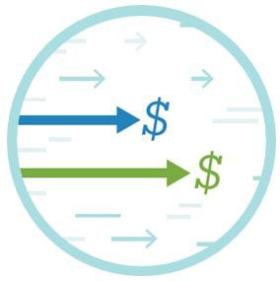
CSF Impacts to Settlements
No changes to ISO’s overarching settlement design
‒ CSF assets largely compensated same as any generator, DARD, or ATRR
‒ Same day-ahead and real-time net commitment-period compensation (NCPC) cost allocation (i.e., same as pumped-storage hydro)
A few adjustments to reflect CSFs:
‒ Enhanced metered quantity for settlement (i.e., energy quantity)
‒ In NCPC rules:
Existing NCPC logic extended to all electric storage facilities, unless specified
“DARD pump” term replaced by “storage DARD”
‒ “Binary storage DARD” specified where applicable
‒ In settlement reports, CSF DARD type identified as “energy storage”
For details, see Enhanced Storage Participation Revisions filing

Slide 87
High-Level Overview of Continuous Storage Facility Settlement Impacts
Includes All Changes Effective April 2019 with Enhanced Storage Participation Revisions
Settlement Type | Calculation Impact | Settlement Report Changes (No New Reports)
Day-Ahead Energy | None | None
Day-Ahead NCPC | Always-committed CSF generator asset treated like fast-start unit | New CSF DARD type identified as “Energy Storage”
Energy Quantity | New calculation method for CSFs | New calculation method identified as “Net Adjustment”
Real-Time Energy | None | New CSF load asset subtype identified as “Energy Storage”
Real-Time NCPC | CSF generator asset uses DDP instead of actual output, if CSF ATRR is regulating CSF generator asset not eligible for real-time NCPC commitment credit or hourly shortfall NCPC credit CSF DARD not eligible for hourly shortfall NCPC credit | New column in SR_RTNCPCGEN5MIN and SR_RTNCPCDARD5MIN reports: Continuous Storage Regulating Flag New CSF credit class identified as “ESD” New reason codes for CSF used in real-time NCPC settlements
Reserve Market | None | None
Regulation Market | DARD real-time load obligation related to regulation dispatch of ATRR is excluded from cost allocation | New columns in SR_REGSUMMARY report: RT Load Obligation for DARDs, Pool RT Load Obligation for DARDs, Subaccount RT Load Obligation for DARDs
Financial Transmission Rights | None | None
Forward Capacity Market | Follows current treatment for pumped storage DARD Excluded from annual peak and peak contribution | None
ISO-NE PUBLIC

Slide 88

Inputs to Energy Quantity Calculation for CSF
New profiling method due to potential use of net metering telemetry
‒ Positive telemetry reported under generator asset
‒ Negative telemetry reported under DARD
Net metering for revenue quality meter (RQM)
‒ If positive:
Generator asset reports positive value
DARD reports 0 value
‒ If negative:
DARD reports negative value
Generator asset reports 0 value

Slide 89
Energy Quantity: New CSF Scaling Factor Calculations (in MW)
Net Revenue Quality Meter
Net Hourly Average Telemetry
12
Non-Zero Telemetry Interval Count
Scaling
Factor
(hour)
Adjusted Scaling
^{Factor}(five-min)
Asset’s Telemetry
Total Telemetry
Scaling Factor_{(hour)}
MW
(five-min)
MW
(five-min)

Slide 90
Example
CSF Energy Quantity Determination in Hourly Settlements
ISO-NE PUBLIC

Slide 91
1. Calculation of Hourly Scaling Factor
(Net RQM – Net Hourly Average Telemetry)
x (12 ÷ Non-Zero Telemetry Interval Count)
Five- Minute Interval | Telemetry MW
 | Gen | DARD | Net
1 | 4 | 0
2 | 4 | 0
3 | 4 | 0
4 | 4 | 0
5 | 4 | 1
6 | 4 | 1
7 | 8 | 2
8 | 8 | 2
9 | 8 | 2
10 | 8 | 2
11 | 0 | 2
12 | 0 | 2
Net Hourly Average Telemetry

Slide 92
1. Calculation of Hourly Scaling Factor, continued
(Net RQM – Net Hourly Average Telemetry)
x (12 ÷ Non-Zero Telemetry Interval Count)
Five- Minute Interval | Telemetry MW
 | Gen | DARD | Net
1 | 4 | 0
2 | 4 | 0
3 | 4 | 0
4 | 4 | 0
5 | 4 | 1
6 | 4 | 1
7 | 8 | 2
8 | 8 | 2
9 | 8 | 2
10 | 8 | 2
11 | 0 | 2
12 | 0 | 2
Net Hourly Average Telemetry
Assumption:
Net Revenue Quality Meter (RQM) | 4
= (4 – ) x (12 ÷ )

Slide 93
1. Calculation of Hourly Scaling Factor, continued
(Net RQM – Net Hourly Average Telemetry)
x (12 ÷ Non-Zero Telemetry Interval Count)
Five- Minute Interval | Telemetry MW
 | Gen | DARD | Net
1 | 4 | 0 | 4
2 | 4 | 0 | 4
3 | 4 | 0 | 4
4 | 4 | 0 | 4
5 | 4 | 1 | 3
6 | 4 | 1 | 3
7 | 8 | 2 | 6
8 | 8 | 2 | 6
9 | 8 | 2 | 6
10 | 8 | 2 | 6
11 | 0 | 2 | −2
12 | 0 | 2 | −2
Net Hourly Average Telemetry |  |  | 3.5
Calculate Net =
Gen − DARD
Assumption:
Net Revenue Quality Meter (RQM) | 4
= (4 – 3.5) x (12 ÷ )

Slide 94
1. Calculation of Hourly Scaling Factor, continued
(Net RQM – Net Hourly Average Telemetry)
x (12 ÷ Non-Zero Telemetry Interval Count)
Five- Minute Interval | Telemetry MW
 | Gen | DARD | Net
1 | 4 | 0 | 4
2 | 4 | 0 | 4
3 | 4 | 0 | 4
4 | 4 | 0 | 4
5 | 4 | 1 | 3
6 | 4 | 1 | 3
7 | 8 | 2 | 6
8 | 8 | 2 | 6
9 | 8 | 2 | 6
10 | 8 | 2 | 6
11 | 0 | 2 | −2
12 | 0 | 2 | −2
Net Hourly Average Telemetry |  |  | 3.5
Calculate Net =
Gen − DARD
Assumption:
Net Revenue Quality Meter (RQM) | 4
= (4 – 3.5) x (12 ÷ 12)
Calculate non-zero telemetry intervals = 12

Slide 95
1. Calculation of Hourly Scaling Factor, continued
(Net RQM – Net Hourly Average Telemetry)
x (12 ÷ Non-Zero Telemetry Interval Count)
Five- Minute Interval | Telemetry MW
 | Gen | DARD | Net
1 | 4 | 0 | 4
2 | 4 | 0 | 4
3 | 4 | 0 | 4
4 | 4 | 0 | 4
5 | 4 | 1 | 3
6 | 4 | 1 | 3
7 | 8 | 2 | 6
8 | 8 | 2 | 6
9 | 8 | 2 | 6
10 | 8 | 2 | 6
11 | 0 | 2 | −2
12 | 0 | 2 | −2
Net Hourly Average Telemetry |  |  | 3.5
Calculate Net =
Gen − DARD
Assumption:
Net Revenue Quality Meter (RQM) | 4
= (4 – 3.5) x (12 ÷ 12)
= 0.5 MW hourly scaling factor
Calculate non-zero telemetry intervals = 12
Carries forward into step #2

Slide 96
2. Calculation of Net Adjusted Energy Quantity
Scaling factor (0.5 MW) added to each five-minute interval
Five- Minute Interval | Telemetry MW
 | Gen | DARD | Net
1 | 4 | 0 | 4
2 | 4 | 0 | 4
3 | 4 | 0 | 4
4 | 4 | 0 | 4
5 | 4 | 1 | 3
6 | 4 | 1 | 3
7 | 8 | 2 | 6
8 | 8 | 2 | 6
9 | 8 | 2 | 6
10 | 8 | 2 | 6
11 | 0 | 2 | −2
12 | 0 | 2 | −2
Net Hourly Average Telemetry |  |  | 3.5
Energy Quantity MW
Net Adj | Gen | DARD
4.5
Scaling factor (+0.5 MW)
applied to first interval:
4 + 0.5 = 4.5 MW

Slide 97
2. Calculation of Net Adjusted Energy Quantity, continued
Scaling factor (0.5 MW) added to each five-minute interval
Five- Minute Interval | Telemetry MW
 | Gen | DARD | Net
1 | 4 | 0 | 4
2 | 4 | 0 | 4
3 | 4 | 0 | 4
4 | 4 | 0 | 4
5 | 4 | 1 | 3
6 | 4 | 1 | 3
7 | 8 | 2 | 6
8 | 8 | 2 | 6
9 | 8 | 2 | 6
10 | 8 | 2 | 6
11 | 0 | 2 | −2
12 | 0 | 2 | −2
Net Hourly Average Telemetry |  |  | 3.5
Energy Quantity MW
Net Adj | Gen | DARD
4.5
4.5
4.5
4.5
3.5
3.5
6.5
6.5
6.5
6.5
−1.5 |  | Average
−1.5 |  | energy qu
4 |  | equal
Scaling factor (+0.5 MW)
applied to
all intervals
net adjusted antity will
net RQM

Slide 98
3. Calculation Of Prorated Five-Minute Energy Quantity in Intervals Where One Asset Reports Zero Value
Net adjusted energy quantity value carries over
Five- Minute Interval | Telemetry MW
 | Gen | DARD | Net
1 | 4 | 0 | 4
2 | 4 | 0 | 4
3 | 4 | 0 | 4
4 | 4 | 0 | 4
5 | 4 | 1 | 3
6 | 4 | 1 | 3
7 | 8 | 2 | 6
8 | 8 | 2 | 6
9 | 8 | 2 | 6
10 | 8 | 2 | 6
11 | 0 | 2 | −2
12 | 0 | 2 | −2
Net Hourly Average Telemetry |  |  | 3.5
Energy Quantity MW
Net Adj | Gen | DARD
4.5 | 4.5 | 0
4.5 | 4.5 | 0
4.5 | 4.5 | 0
4.5 | 4.5 | 0
3.5
3.5
6.5
6.5
6.5
6.5
−1.5
−1.5
4
A
Generator asset
reflects positive value and DARD is 0

Slide 99
3. Calculation Of Prorated Five-Minute Energy Quantity in Intervals Where One Asset Reports Zero Value, continued
Net adjusted energy quantity value carries over
Five- Minute Interval | Telemetry MW
 | Gen | DARD | Net
1 | 4 | 0 | 4
2 | 4 | 0 | 4
3 | 4 | 0 | 4
4 | 4 | 0 | 4
5 | 4 | 1 | 3
6 | 4 | 1 | 3
7 | 8 | 2 | 6
8 | 8 | 2 | 6
9 | 8 | 2 | 6
10 | 8 | 2 | 6
11 | 0 | 2 | −2
12 | 0 | 2 | −2
Net Hourly Average Telemetry |  |  | 3.5
Energy Quantity MW
Net Adj | Gen | DARD
4.5 | 4.5 | 0
4.5 | 4.5 | 0
4.5 | 4.5 | 0
4.5 | 4.5 | 0
3.5
3.5
6.5
6.5
6.5
6.5
−1.5 | 0 | −1.5
−1.5 | 0 | −1.5
4
A
Generator asset
reflects positive value and DARD is 0
B
DARD reflects
negative value and
generator asset is 0

Slide 100
4. Calculation of Prorated Five-Minute Energy Quantity in Intervals Where
Both Assets Report Non-Zero Value
Adjusted scaling factor applied to telemetry values
A Calculate Gen adjusted scaling factor
Five- Minute Interval | Telemetry MW
 | Gen | DARD | Net
1 | 4 | 0 | 4
2 | 4 | 0 | 4
3 | 4 | 0 | 4
4 | 4 | 0 | 4
5 | 4 | 1 | 3
6 | 4 | 1 | 3
7 | 8 | 2 | 6
8 | 8 | 2 | 6
9 | 8 | 2 | 6
10 | 8 | 2 | 6
11 | 0 | 2 | −2
12 | 0 | 2 | −2
Net Hourly Average Telemetry |  |  | 3.5
Energy Quantity MW
Net Adj | Gen | DARD
4.5 | 4.5 | 0
4.5 | 4.5 | 0
4.5 | 4.5 | 0
4.5 | 4.5 | 0
3.5
3.5
6.5
6.5
6.5
6.5
−1.5 | 0 | −1.5
−1.5 | 0 | −1.5
4
= Scaling Factor_{(hour)} x (Asset’s Telemetry MW_{(five-min)}
÷ Total Telemetry MW_{(five-min)})
= 0.5 x (4 ÷ [4 + 1]) = 0.5 x (4 ÷ 5) = 0.4

Slide 101
4. Calculation of Prorated Five-Minute Energy Quantity in Intervals Where
Both Assets Report Non-Zero Value, continued
Adjusted scaling factor applied to telemetry values
A Calculate Gen adjusted scaling factor
= Scaling Factor_{(hour)} x (Asset’s Telemetry MW_{(five-min)}
÷ Total Telemetry MW_{(five-min)})
= 0.5 x (4 ÷ [4 + 1]) = 0.5 x (4 ÷ 5) = 0.4
Five- Minute Interval | Telemetry MW
 | Gen | DARD | Net
1 | 4 | 0 | 4
2 | 4 | 0 | 4
3 | 4 | 0 | 4
4 | 4 | 0 | 4
5 | 4 | 1 | 3
6 | 4 | 1 | 3
7 | 8 | 2 | 6
8 | 8 | 2 | 6
9 | 8 | 2 | 6
10 | 8 | 2 | 6
11 | 0 | 2 | −2
12 | 0 | 2 | −2
Net Hourly Average Telemetry |  |  | 3.5
Energy Quantity MW
Net Adj | Gen | DARD
4.5 | 4.5 | 0
4.5 | 4.5 | 0
4.5 | 4.5 | 0
4.5 | 4.5 | 0
3.5 | 4.4
3.5
6.5
6.5
6.5
6.5
−1.5 | 0 | −1.5
−1.5 | 0 | −1.5
4
B
Calculate Gen energy quantity MW
= Adjusted Scaling Factor_{(five-min)}
+ Gen Telemetry MW
= 0.4 + 4 = 4.4

Slide 102
4. Calculation of Prorated Five-Minute Energy Quantity in Intervals Where
Both Assets Report Non-Zero Value, continued
Adjusted scaling factor applied to telemetry values
A Calculate Gen adjusted scaling factor
= Scaling Factor_{(hour)} x (Asset’s Telemetry MW_{(five-min)}
÷ Total Telemetry MW_{(five-min)})
= 0.5 x (4 ÷ [4 + 1]) = 0.5 x (4 ÷ 5) = 0.4
Five- Minute Interval | Telemetry MW
 | Gen | DARD | Net
1 | 4 | 0 | 4
2 | 4 | 0 | 4
3 | 4 | 0 | 4
4 | 4 | 0 | 4
5 | 4 | 1 | 3
6 | 4 | 1 | 3
7 | 8 | 2 | 6
8 | 8 | 2 | 6
9 | 8 | 2 | 6
10 | 8 | 2 | 6
11 | 0 | 2 | −2
12 | 0 | 2 | −2
Net Hourly Average Telemetry |  |  | 3.5
Energy Quantity MW
Net Adj | Gen |  | DARD
4.5 | 4.5 |  | 0
4.5 | 4.5 |  | 0
4.5 | 4.5 |  | 0
4.5 | 4.5 |  | 0
3.5 | 4.4
3.5
6.5
6.5
6.5
6.5
−1.5 | 0 |  | −1.5
−1.5 | 0 |  | −1.5
4
B Calculate Gen energy quantity MW
= Adjusted Scaling Factor_{(five-min)}
+ Gen Telemetry MW
= 0.4 + 4 = 4.4
C Calculate DARD adjusted scaling factor
= Scaling Factor_{(hour)} x (Asset’s Telemetry MW_{(five-min)}
÷ Total Telemetry MW_{(five-min)})
= 0.5 x (1 ÷ [4 + 1]) = 0.5 x (1 ÷ 5) = 0.1

Slide 103
4. Calculation of Prorated Five-Minute Energy Quantity in Intervals Where
Both Assets Report Non-Zero Value, continued
Adjusted scaling factor applied to telemetry values
A Calculate Gen adjusted scaling factor
= Scaling Factor_{(hour)} x (Asset’s Telemetry MW_{(five-min)}
÷ Total Telemetry MW_{(five-min)})
= 0.5 x (4 ÷ [4 + 1]) = 0.5 x (4 ÷ 5) = 0.4
Five- Minute Interval | Telemetry MW
 | Gen | DARD | Net
1 | 4 | 0 | 4
2 | 4 | 0 | 4
3 | 4 | 0 | 4
4 | 4 | 0 | 4
5 | 4 | 1 | 3
6 | 4 | 1 | 3
7 | 8 | 2 | 6
8 | 8 | 2 | 6
9 | 8 | 2 | 6
10 | 8 | 2 | 6
11 | 0 | 2 | −2
12 | 0 | 2 | −2
Net Hourly Average Telemetry |  |  | 3.5
Energy Quantity MW
Net Adj | Gen |  | DARD
4.5 | 4.5 |  | 0
4.5 | 4.5 |  | 0
4.5 | 4.5 |  | 0
4.5 | 4.5 |  | 0
3.5 | 4.4 |  | −0.9
3.5
6.5
6.5
6.5
6.5
−1.5 | 0 |  | −1.5
−1.5 | 0 |  | −1.5
4
B Calculate Gen energy quantity MW
= Adjusted Scaling Factor_{(five-min)}
+ Gen Telemetry MW
= 0.4 + 4 = 4.4
C Calculate DARD adjusted scaling factor
= Scaling Factor_{(hour)} x (Asset’s Telemetry MW_{(five-min)}
÷ Total Telemetry MW_{(five-min)})
= 0.5 x (1 ÷ [4 + 1]) = 0.5 x 1 ÷ 5 = 0.1
D Calculate DARD energy quantity MW
= Adjusted Scaling Factor_{(five-min)}
− DARD Telemetry MW
= 0.1 – 1 = −0.9

Slide 104
4. Calculation of Prorated Five-Minute Energy Quantity in Intervals Where
Both Assets Report Non-Zero Value, continued
Adjusted scaling factor applied to telemetry values
A Calculate Gen adjusted scaling factor
= Scaling Factor_{(hour)} x (Asset’s Telemetry MW_{(five-min)}
÷ Total Telemetry MW_{(five-min)})
= 0.5 x (4 ÷ [4 + 1]) = 0.5 x (4 ÷ 5) = 0.4
Five- Minute Interval | Telemetry MW
 | Gen | DARD | Net
1 | 4 | 0 | 4
2 | 4 | 0 | 4
3 | 4 | 0 | 4
4 | 4 | 0 | 4
5 | 4 | 1 | 3
6 | 4 | 1 | 3
7 | 8 | 2 | 6
8 | 8 | 2 | 6
9 | 8 | 2 | 6
10 | 8 | 2 | 6
11 | 0 | 2 | −2
12 | 0 | 2 | −2
Net Hourly Average Telemetry |  |  | 3.5
Energy Quantity MW
Net Adj | Gen |  | DARD
4.5 | 4.5 |  | 0
4.5 | 4.5 |  | 0
4.5 | 4.5 |  | 0
4.5 | 4.5 |  | 0
3.5 | 4.4 |  | −0.9
3.5 | 4.4 |  | −0.9
6.5 | 8.4 |  | −1.9
6.5 | 8.4 |  | −1.9
6.5 | 8.4 |  | −1.9
6.5 | 8.4 |  | −1.9
−1.5 | 0 |  | −1.5
−1.5 | 0 |  | −1.5
4 | 5.03 |  | −1.03
B Calculate Gen energy quantity MW
= Adjusted Scaling Factor_{(five-min)}
+ Gen Telemetry MW
= 0.4 + 4 = 4.4
C Calculate DARD adjusted scaling factor
= Scaling Factor_{(hour)} x (Asset’s Telemetry MW_{(five-min)}
÷ Total Telemetry MW_{(five-min)})
= 0.5 x (1 ÷ [4 + 1]) = 0.5 x 1 ÷ 5 = 0.1
D Calculate DARD energy quantity MW
= Adjusted Scaling Factor_{(five-min)}
− DARD Telemetry MW
= 0.1 – 1 = −0.9
E Repeat A–D for remaining intervals

Slide 105
Calculated CSF Energy Quantity Values Can Be Found in Settlements Report
Real-Time Asset 5 Minute Energy Quantity*
Trading Interval | Hour End | Asset Name | Asset Type | Calculation Method | Telemetry Value | Energy Quantity
Interval Begin | Hour End |  |  |  | MW | MW
00:00 | 1 | MyFacility_GEN | GENERATOR | NET ADJUSTMENT | 4 | 4.5
00:05 | 1 | MyFacility_GEN | GENERATOR | NET ADJUSTMENT | 4 | 4.5
00:10 | 1 | MyFacility_GEN | GENERATOR | NET ADJUSTMENT | 4 | 4.5
00:15 | 1 | MyFacility_GEN | GENERATOR | NET ADJUSTMENT | 4 | 4.5
00:20 | 1 | MyFacility_GEN | GENERATOR | NET ADJUSTMENT | 4 | 4.4
00:25 | 1 | MyFacility_GEN | GENERATOR | NET ADJUSTMENT | 4 | 4.4
00:30 | 1 | MyFacility_GEN | GENERATOR | NET ADJUSTMENT | 8 | 8.4
00:35 | 1 | MyFacility_GEN | GENERATOR | NET ADJUSTMENT | 8 | 8.4
00:40 | 1 | MyFacility_GEN | GENERATOR | NET ADJUSTMENT | 8 | 8.4
00:45 | 1 | MyFacility_GEN | GENERATOR | NET ADJUSTMENT | 8 | 8.4
00:50 | 1 | MyFacility_GEN | GENERATOR | NET ADJUSTMENT | 0 | 0
00:55 | 1 | MyFacility_GEN | GENERATOR | NET ADJUSTMENT | 0 | 0
00:00 | 1 | MyFacility_ARD | ASSET RELATED DEMAND | NET ADJUSTMENT | 0 | 0
00:05 | 1 | MyFacility_ARD | ASSET RELATED DEMAND | NET ADJUSTMENT | 0 | 0
00:10 | 1 | MyFacility_ARD | ASSET RELATED DEMAND | NET ADJUSTMENT | 0 | 0
00:15 | 1 | MyFacility_ARD | ASSET RELATED DEMAND | NET ADJUSTMENT | 0 | 0
00:20 | 1 | MyFacility_ARD | ASSET RELATED DEMAND | NET ADJUSTMENT | 1 | −0.9
00:25 | 1 | MyFacility_ARD | ASSET RELATED DEMAND | NET ADJUSTMENT | 1 | −0.9
00:30 | 1 | MyFacility_ARD | ASSET RELATED DEMAND | NET ADJUSTMENT | 2 | −1.9
00:35 | 1 | MyFacility_ARD | ASSET RELATED DEMAND | NET ADJUSTMENT | 2 | −1.9
00:40 | 1 | MyFacility_ARD | ASSET RELATED DEMAND | NET ADJUSTMENT | 2 | −1.9
00:45 | 1 | MyFacility_ARD | ASSET RELATED DEMAND | NET ADJUSTMENT | 2 | −1.9
00:50 | 1 | MyFacility_ARD | ASSET RELATED DEMAND | NET ADJUSTMENT | 2 | −1.5
00:55 | 1 | MyFacility_ARD | ASSET RELATED DEMAND | NET ADJUSTMENT | 2 | −1.5
Look for them under “Energy Quantity”
Values used as inputs for other settlement calculations
*For illustration only; actual report includes other data not shown here
103
ISO-NE PUBLIC

Slide 106
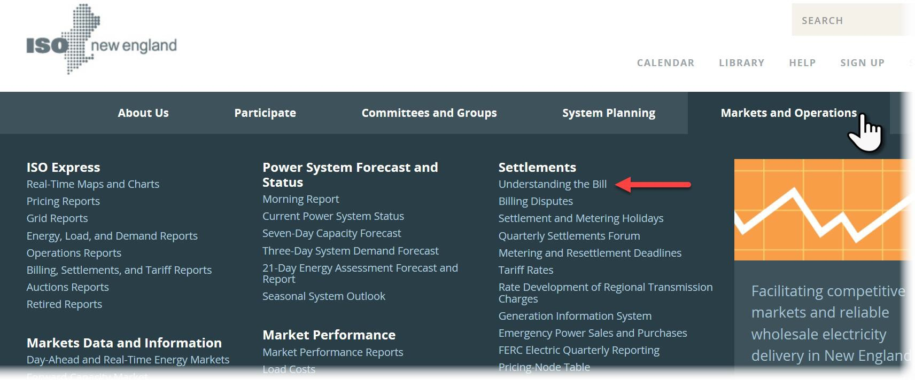
CSF Registration Does Not Impact Billing
No changes to billing process or billable line-item descriptions
If new to ISO New England, see billing resources:
‒ Understanding the Bill webpage
‒ Billing Process Summary—brief introduction to billing process for new customers and guide to available settlement-related resources

Slide 107
Questions?
CILBPU EN-ISO
Coming Up:
Additional Resources
ISO-NE PUBLIC

Slide 108
Additional Resources
ISO-NE PUBLIC

Slide 109

Learn More at iso-ne.com
Continuous storage facility information
‒ Energy Storage Device (ESD) Project Customer Readiness Webpage
‒ March 7, 2019, Quarterly Settlements Forum
General market participation
‒ Flowchart of Energy Storage Registration Options (see appendix)
‒ Energy Storage Market Participation Overview Webinar (recording; slides)
‒ New Capacity Qualification for Energy Storage Resources Webinar (recording; slides)
‒ WEM 101: Introduction to Wholesale Electricity Markets (see Upcoming Courses webpage)
‒ Regulation Market
Regulation Market Settlements: Calculations and Examples
‒ Understanding the Bill: Information to help reconcile billing statements, including detailed guidance on billable line items and report samples
Staying informed
‒ ISO Training mailing list: announcements of upcoming learning opportunities
‒ Upcoming Courses: list of scheduled webinars and classroom trainings
‒ ISO Training Materials: recordings and slides of past trainings
‒ ISO Quarterly Settlements Forum (March, June, September, December)

Slide 110
Summary
Today’s training covered:
The continuous storage facility option for participation in New England’s wholesale electricity markets
How to register as a continuous storage facility
Requirements for managing CSF assets in eMarket software platform
Examples of how CSF may offer or bid in to markets
Related settlement changes
Where to find information on alternative options that storage facilities have for market participation
Where to find other helpful resources

Slide 111
Slide added on 12/31/2024.

Slide 112
Appendix
CILBPU EN-ISO
ISO-NE PUBLIC

Slide 113









Flowchart of Energy Storage Registration Options
Required Registration Types
Market Products
YES
Will facility offer regulation
YES
Must register as three assets: modeled dispatchable generator asset, DARD, and ATRR
Is facility
≥5 MW?
Continuous storage
Energy, reserves, regulation, capacity
service?
facility
NO
NO
Modeled
generator
≥5 MW generator centrally dispatched by ISO control room and monitored in real time
Energy, reserves,
capacity
Will facility
YES
offer
Settlement-
<5 MW generator not centrally dispatched by ISO control room and not monitored in real time
energy,
only
Energy, capacity
reserves, &
generator
regulation?
Dual registration allowed
NO
ATRR
Receives energy- neutral dispatch signal
Regulation
ISO-NE PUBLIC

